Slide 1
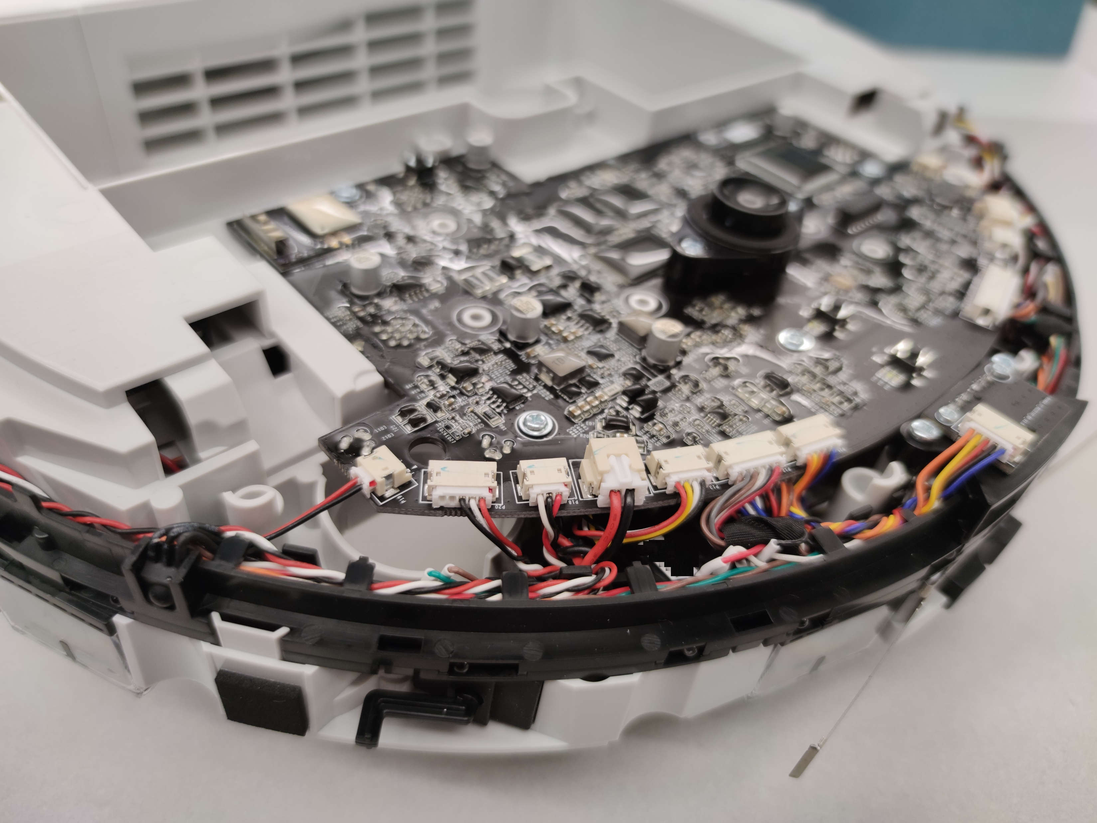
Dreame technical information and rooting:
Get control over your vacuum robot
Notes:
Welcome to the rooting how-to of the Dreame robots. Here I will show you how to get control over your vacuum robot

Slide 2
Before you continue: Please look thru all slides and the FAQ before you start your adventure
All commands and FAQ can be found here:
https://builder.dontvacuum.me/dreame/
You might want to join the Telegram channel:
https://t.me/dust_announce
Notes:
Before we start a few comments. Please watch the whole video before you start your adventure. If you don’t have a technical background, you might be overwhelmed with this.
All the commands we use here are linked in the description. You can copy and paste them from the cheatsheet.

Slide 3
Good news: No soldering or teardown required

Slide 4
Why get root access?
Use Valetudo (https://valetudo.cloud/)
Replace the cloud functionality with an open-source software
Integrate the device into your home automation
Install your own soundfiles/voices
Notes:
Ok, lets talk why do we want to get root access in the first place.
Many users purchased their robot as the T6 model, which is geo-blocked outside of Mainland china. With root access you can remove this geo-blocking.
Probably the most important reason is to use the Valetudo software, which replaces the cloud functionality with open source software. This also enables you to integrate the device in your home automation software.
Also we can install our own soundfiles and voices.

Slide 5
Currently tested devices (02.2022)
Xiaomi Vacuum 1C: UART*/Reset**/Livesuit
Dreame D9 (normal and Pro): UART*/Reset*/Livesuit
Dreame F9: UART*/Reset*/Livesuit
Xiaomi Vacuum 1T: Reset*/Livesuit***
Dreame L10 Pro: Reset*/Livesuit***
Dreame Z10 Pro: Reset*/Livesuit***
Mova Z500: Reset*/Livesuit
* Method patched in new versions, check https://dontvacuum.me/robotinfo/
** Method might not be available in too old or too new versions.
*** Method likely to be patched with future firmware updates

Slide 6
Risks
A failed flash can leave the device in an undefined state
Requires reflashing
Problem:
All partitions need to be recreated
Device identity (Device ID, Cloud keys, MAC) gets lost
Calibration data lost
Observations:
Device identity does not matter if you use Valetudo
Unknown consequences for lost calibration data

Slide 7
More risks
Problem: Hardware differs even for the same „model“
The root method cannot verify your exact model
Flashing an incorrect firmware will perma-damage your device
Other, not obvious side effects might occur
Recovery might be tricky and can cause problems
Important: Make sure that you have the correct firmware
Do not try to use the same generated firmware on multiple devices
If you are unsure, ask us first!

Slide 8
Sidenotes
Rooting will permanently change files on your device*
Cloud connection / App usage should be still possible
By installing a custom firmware, you cannot update your device with official firmwares anymore **
That is the price of rooting
You can update your device with custom firmwares
Connect to your robot and write down the MAC address
* we needed to reconstruct parts from the firmware by extracting contents from flash and guessing unknown parts.
** if you backup the encryption keys, you can restore them at a future time. In special circumstances (dead hardware) we might provide you with stock firmware.

Slide 9
Important information
DO NOT UPDATE THE FIRMWARE VIA THE APP if you ever plan to root your device
New firmwares have rooting methods patched
Root might be still possible, but is more complicated and risky
Before rooting: test the device without using the app
Fully charge your device
Use the buttons to start the cleaning run
Let the robot clean multiple times
Background: Some devices come with defects from the factory. It is tricky to figure out if your robot behaves weirdly due to it being already broken or due to rooting

Slide 10
Current available rooting methods
UART
Requires: UART connection
Idea: Interrupting the bootloader, boot into single-user-mode, flash firmware
Reset (Currently recommended)
Requires: UART connection
Idea: trigger the secret login shell by pressing reset <=1 sec, compute root password, login, flash firmware
Livesuit
Requires: USB connection, UART (recommended but not required)
Idea: creation of special factory image, triggering bootrom mode (FEL), flashing of all partitions via Livesuit software (requires Windows)

Slide 11
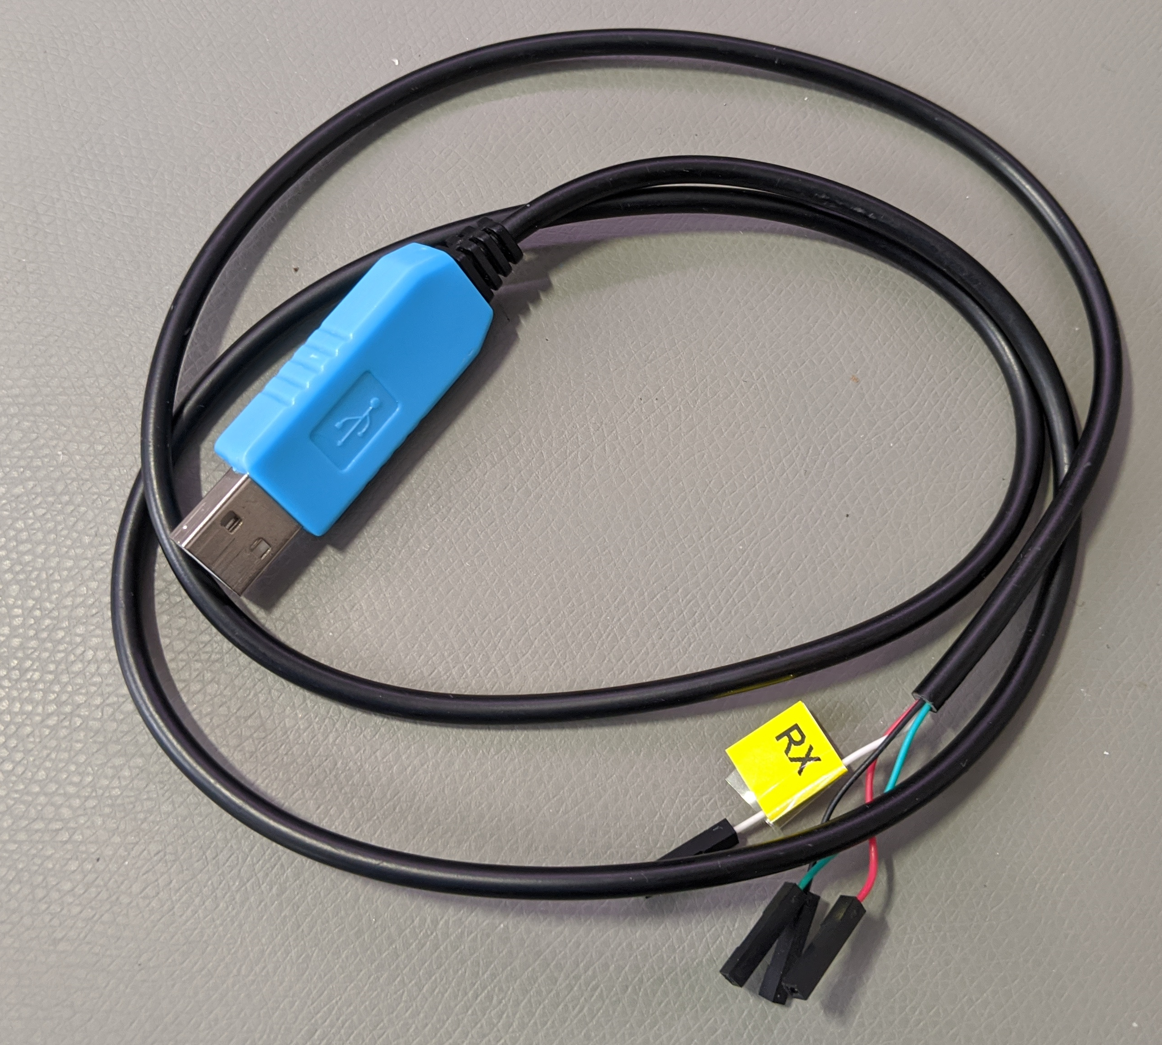
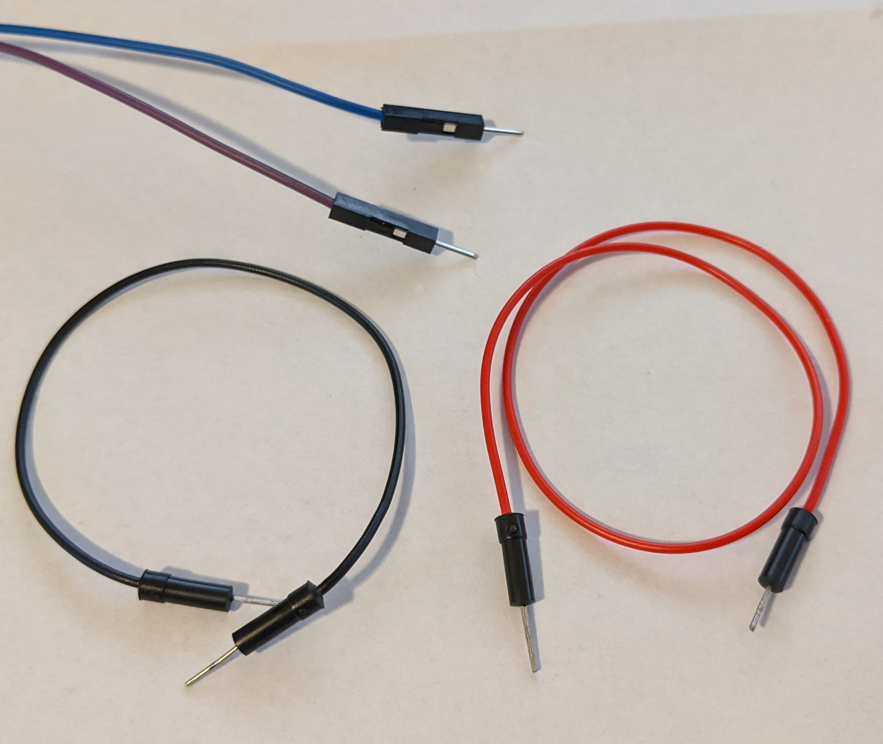
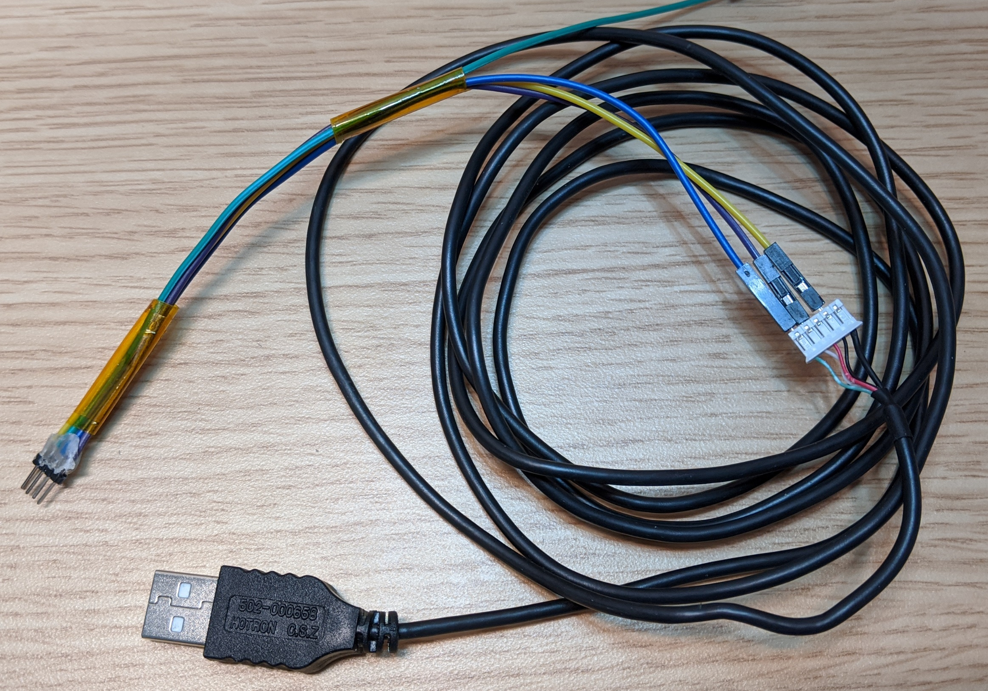
Tools required for root
UART-USB adapter (3.3V, aka TTL adapter)
Typical chipsets:
FT232RL, FT232, PL2303TA or CP2102
Price ~10 USD/Euro
Breadboard Jumper Wires
2mm pitch headers
USB cable (for Livesuit/FEL)
(e.g. from a broken USB mouse)
Alternative: custom PCBs
Notes:
To root the devices we need a few tools. We need screwdrivers to disassemble the device. I created a step by step video about how to do that. Its linked in the description.
Also we need a UART to USB adapter. You might find them under various names, like serial adapters or TTL adapters. The important thing here is that they support 3.3V logic level. Usually you can get them very cheaply over amazon or even in local stores.
For the actual connection, we need a few thing isolated copper wires or some breadboard jumper wires. Also some tape might be helpful.

Slide 12
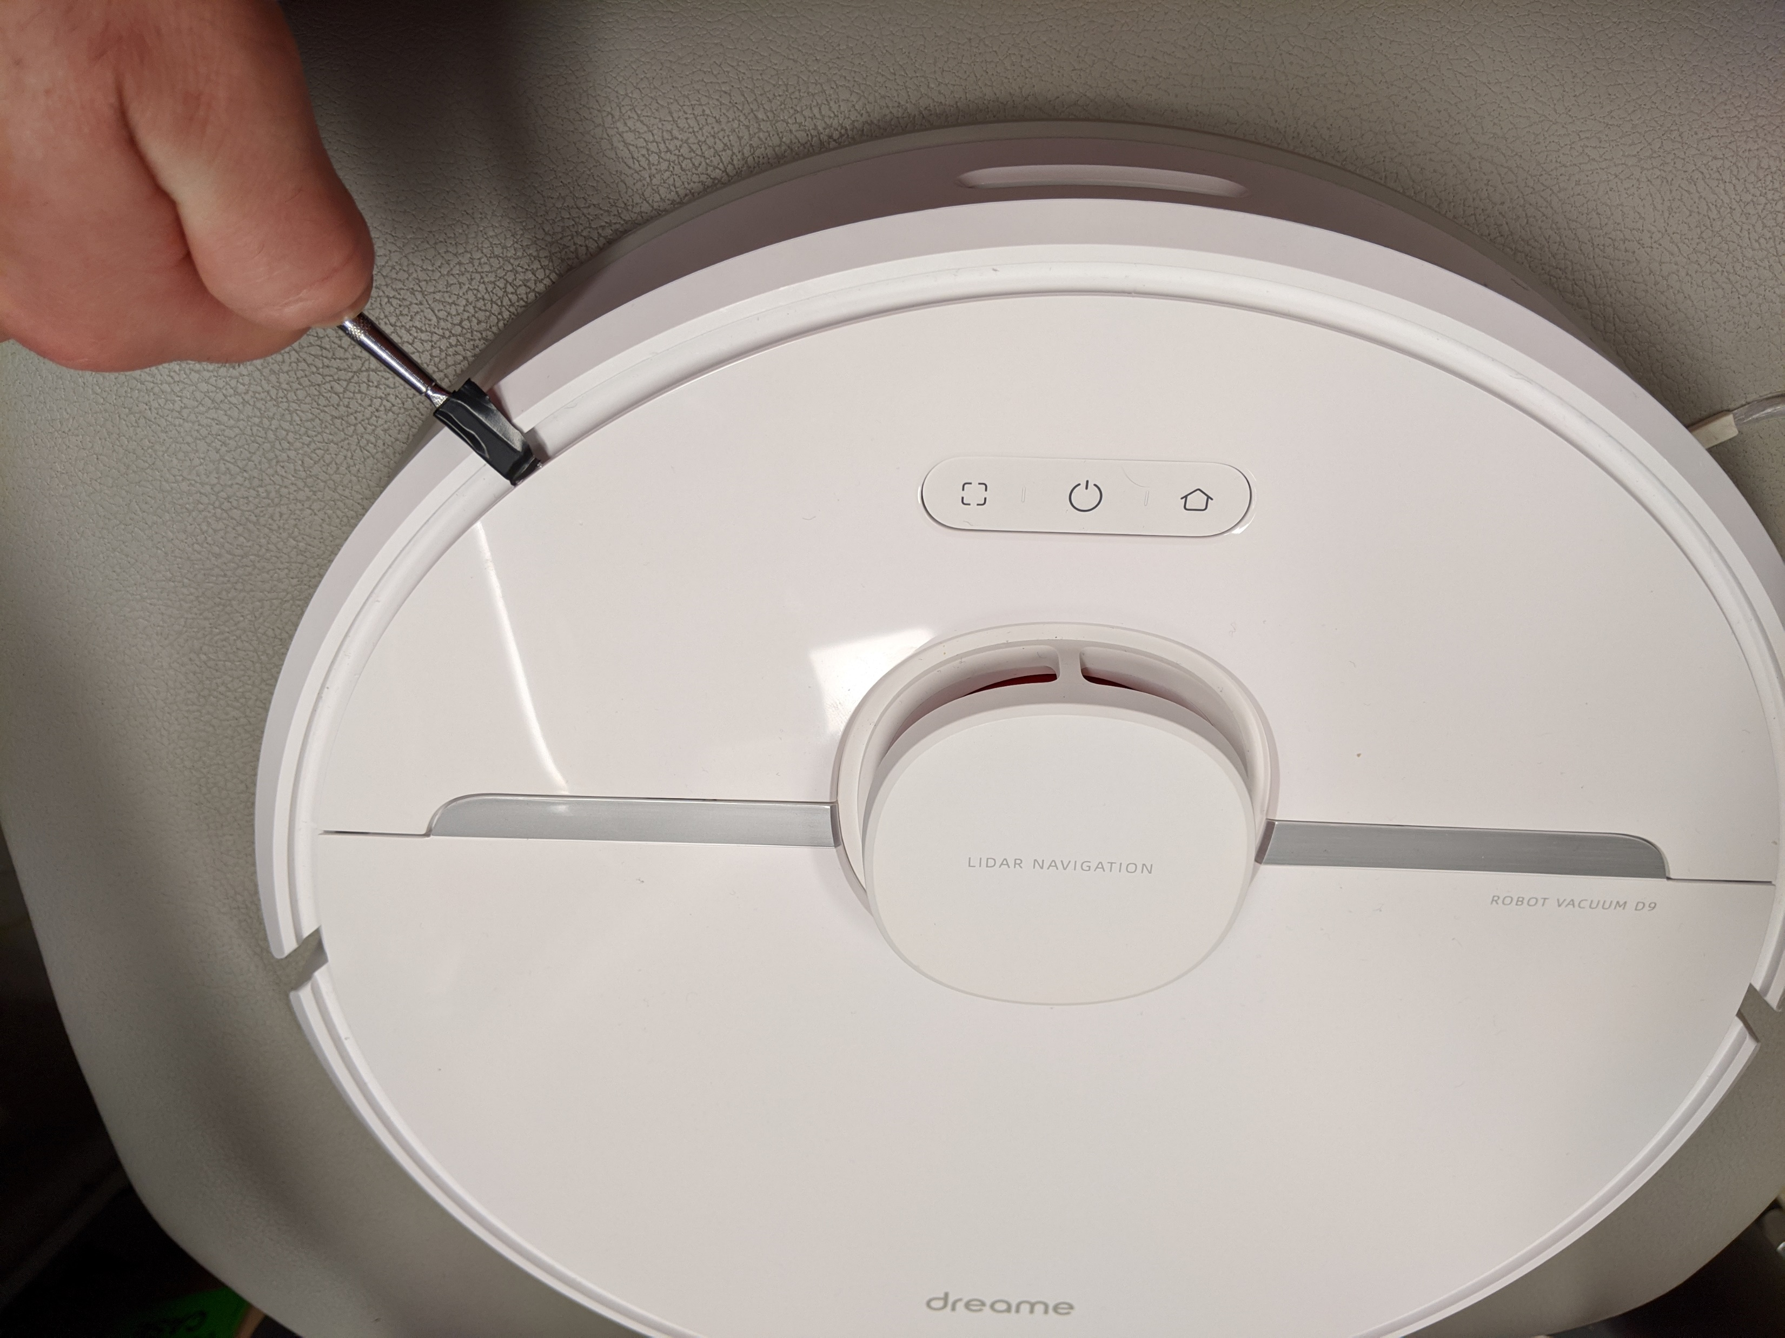
Opening the device

Slide 13
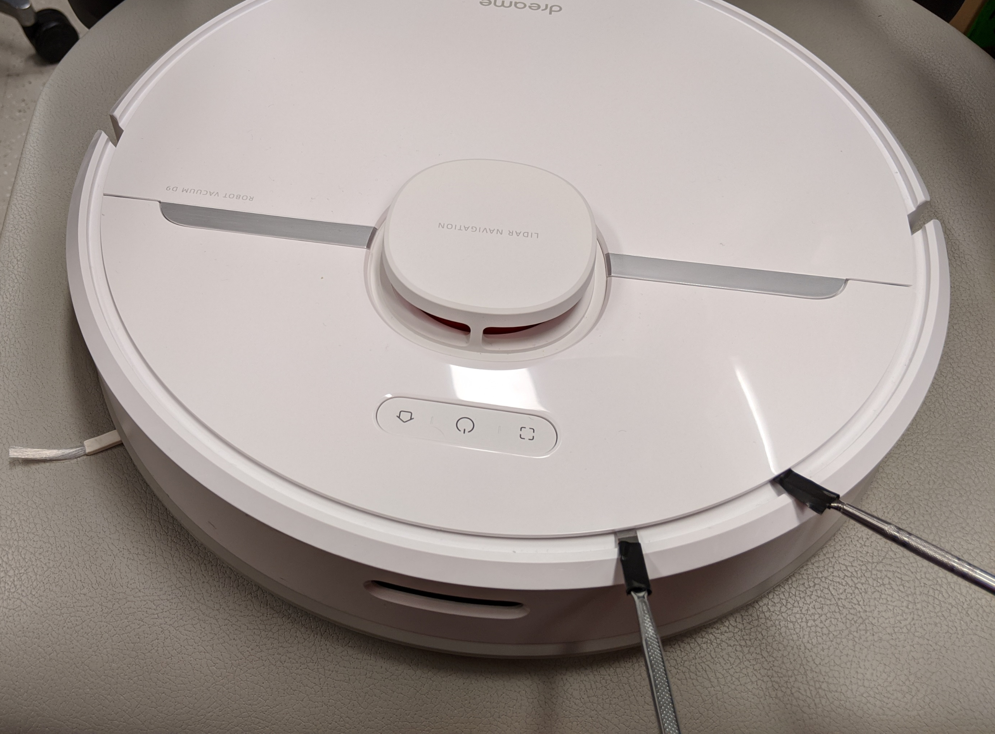
Opening the device

Slide 14
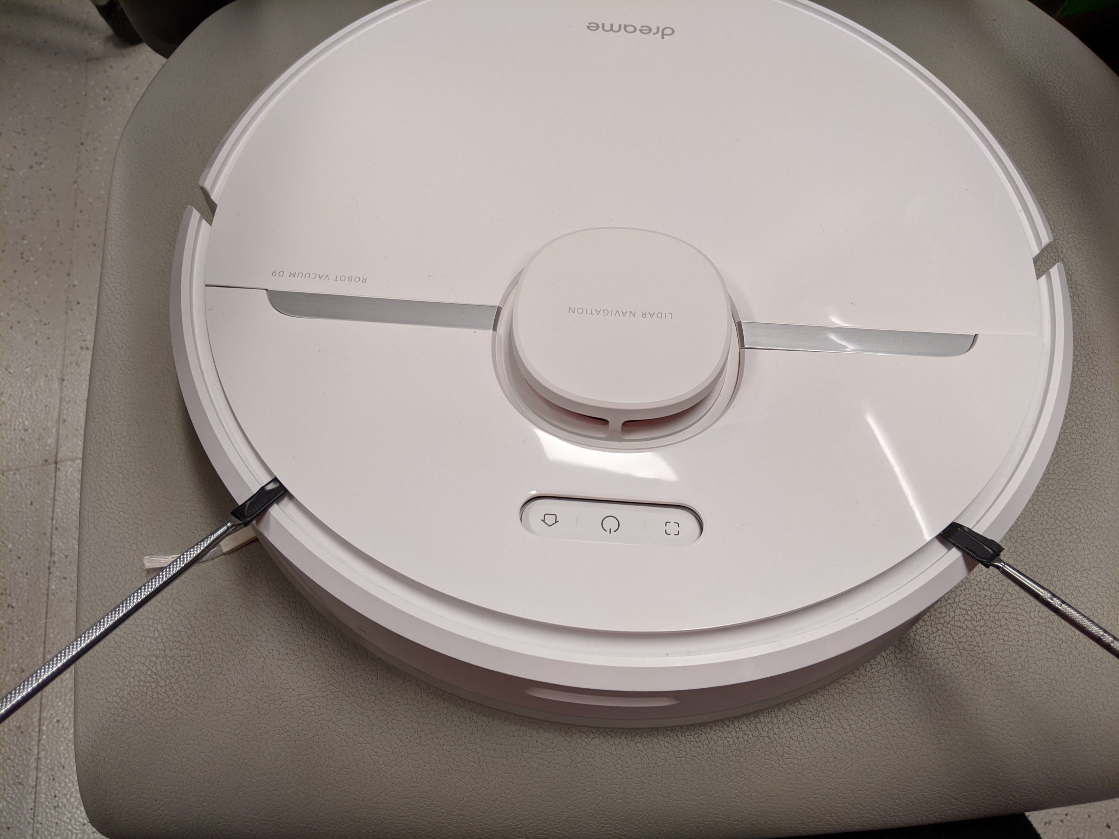
Opening the device

Slide 15
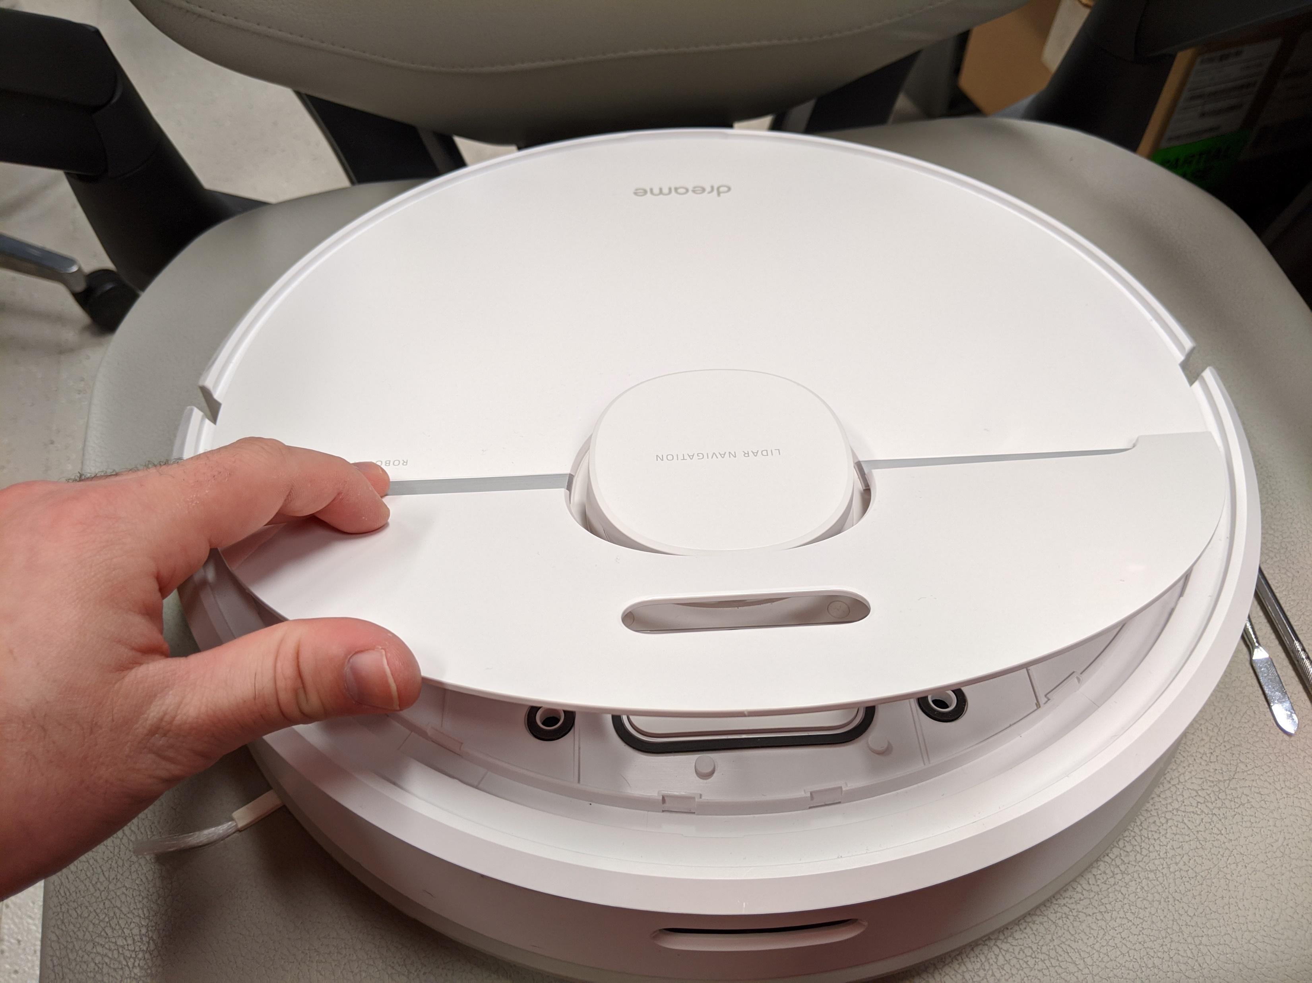
Opening the device

Slide 16
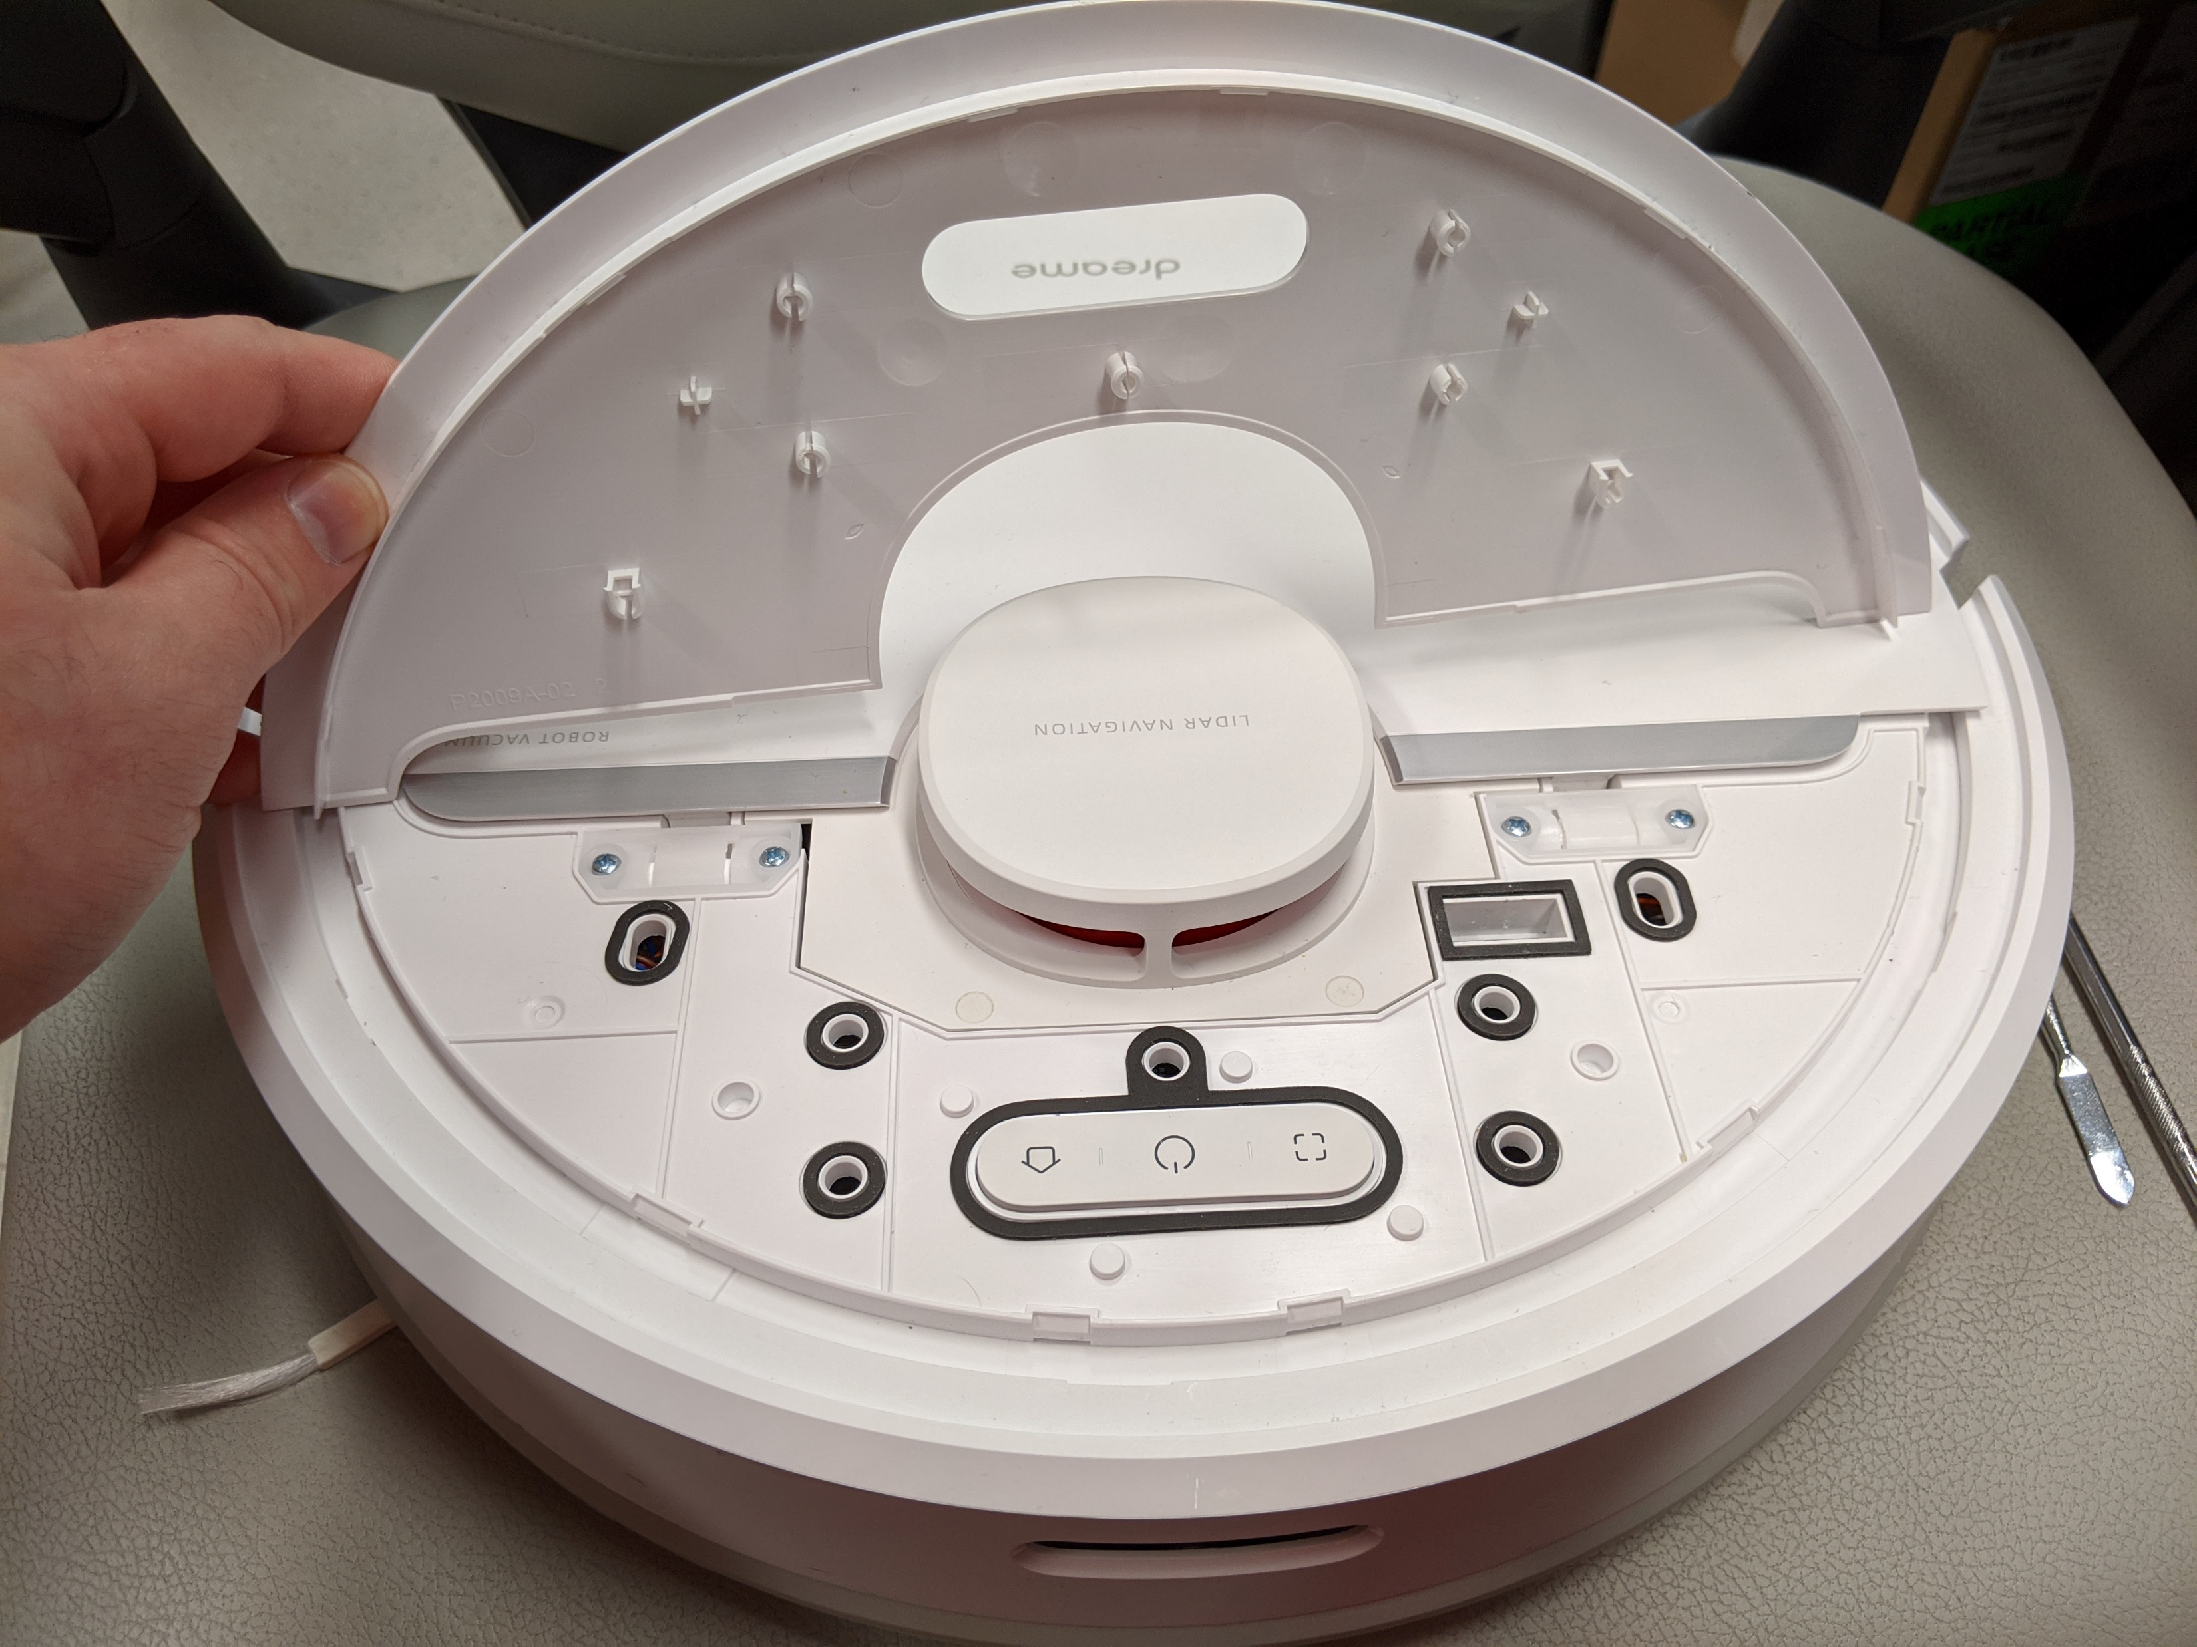
Opening the device

Slide 17
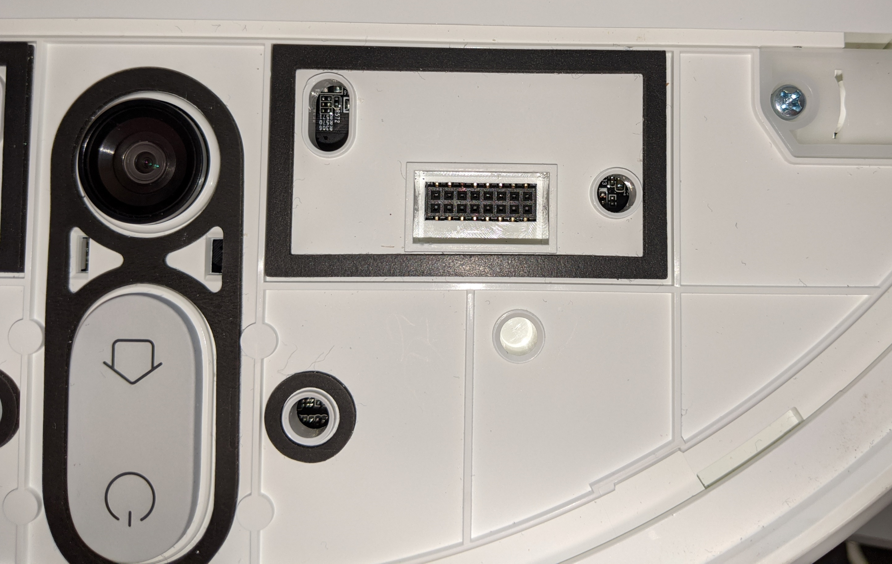
Debug pinout
Debuginterface
2x8 pins
2mm pitch size
Dontvacuum.me
GND
Warning:
2mm pitch size is way smaller
than the usual 2.54 mm
VBUS
(Do not connect)
Boot_SEL
Warning:
Make sure you connect to the
correct pins!
RX
TX
D+
D-
Front

Slide 18
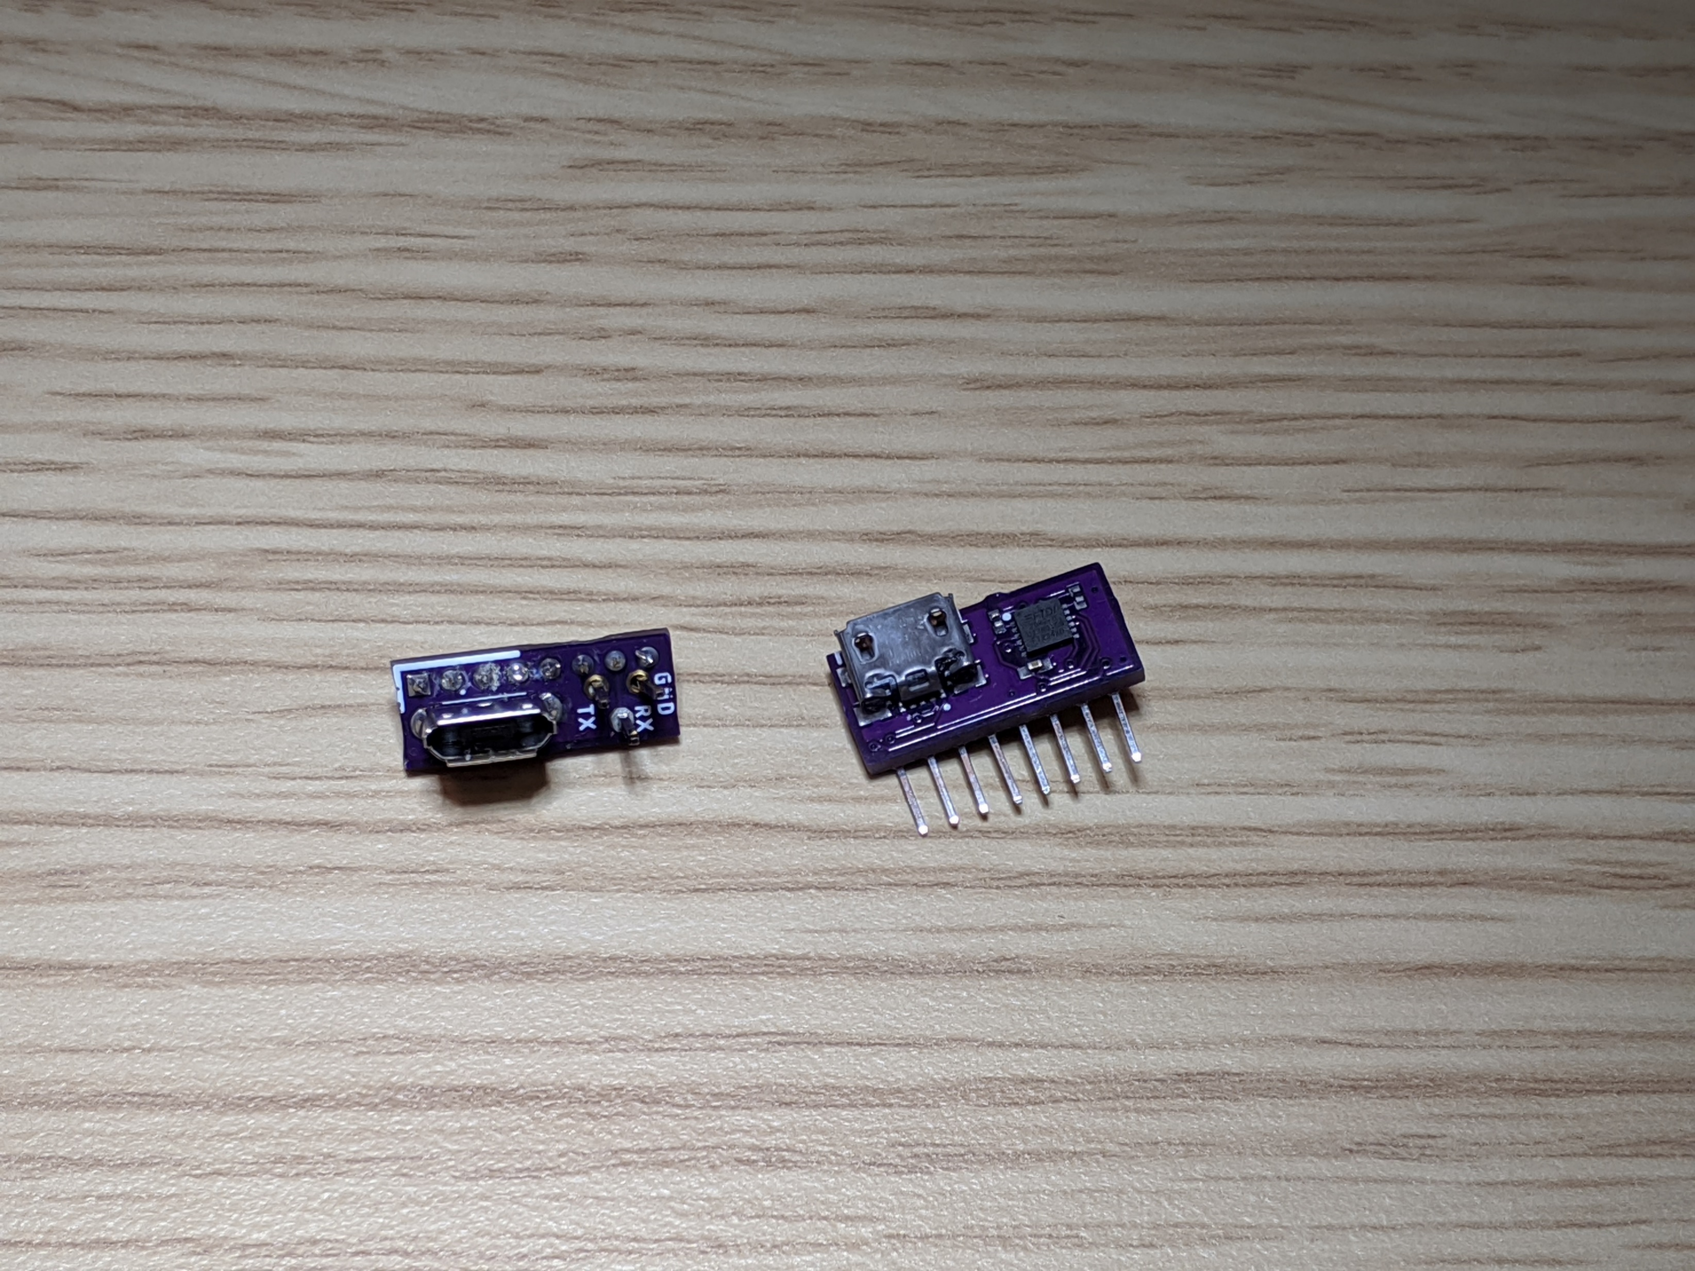
Rooting with custom PCBs
USB + UART headers
(aka basic PCB)
USB + integrated UART
Adapter
(aka Advanced PCB)
Check builder.dontvacuum.me/dreameadapter for the Gerber files

Slide 19
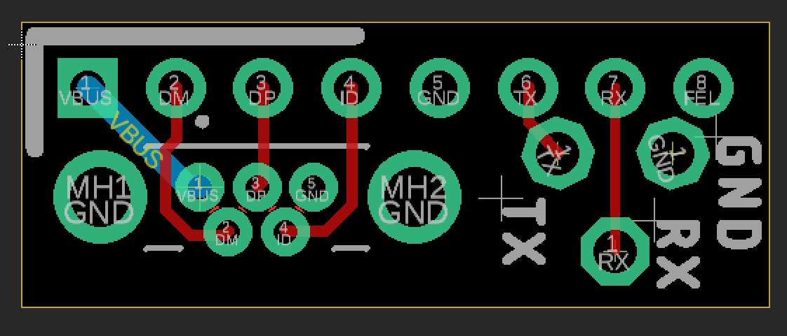
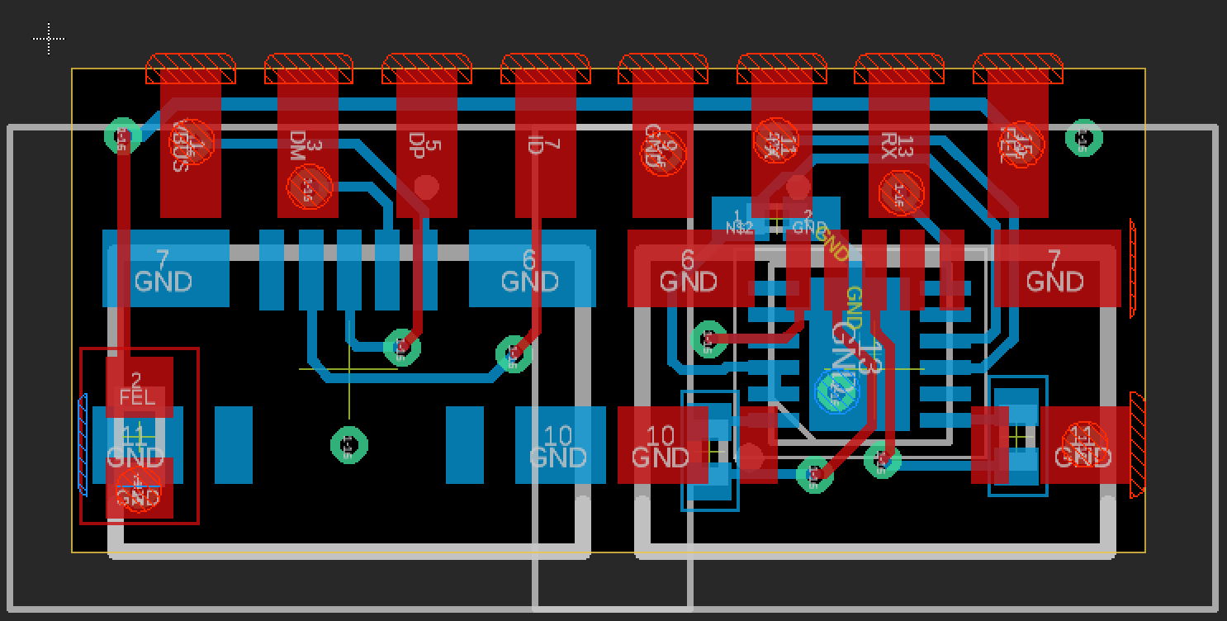
Rooting with custom PCBs
USB + UART headers
(aka basic PCB)
USB + integrated UART
Adapter
(aka Advanced PCB)
Check builder.dontvacuum.me/dreameadapter for the Gerber files

Slide 20
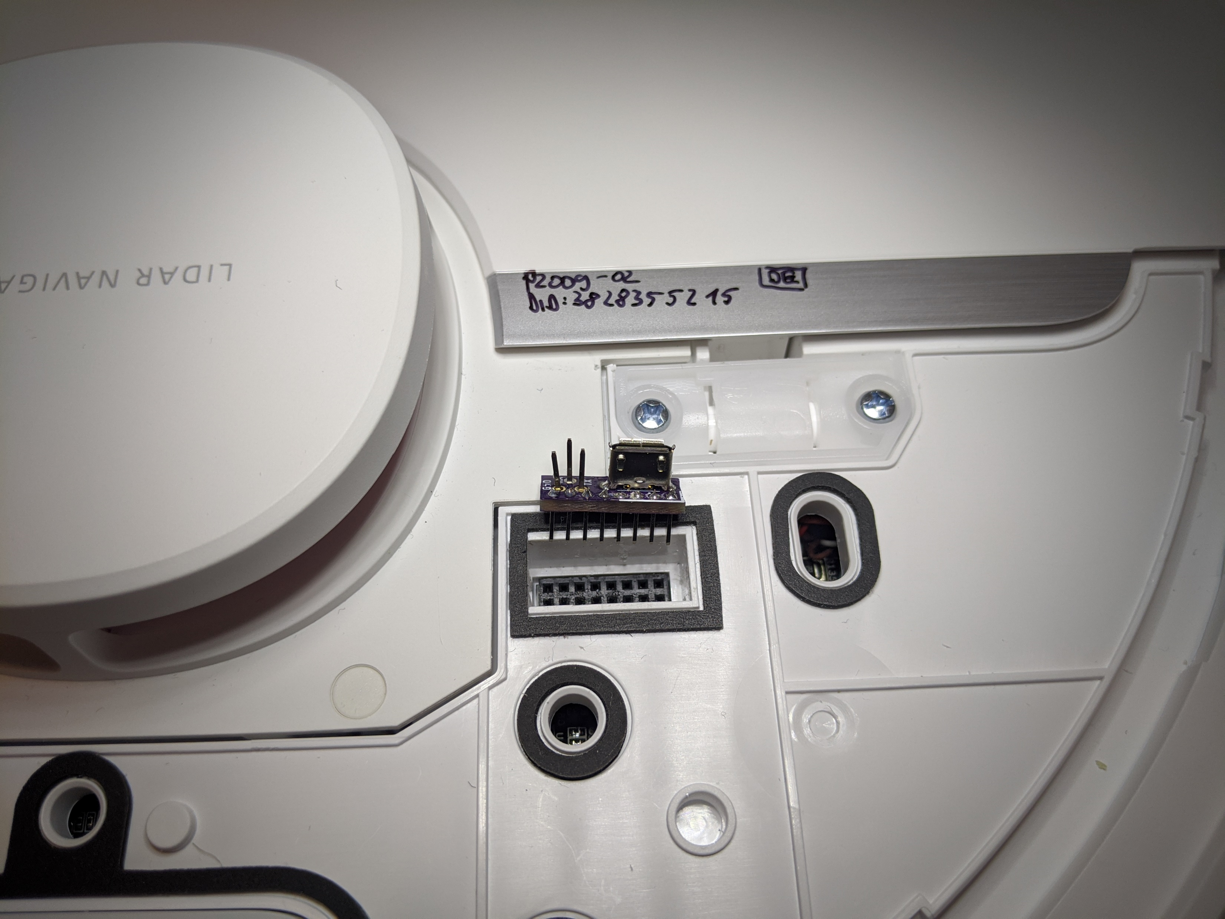
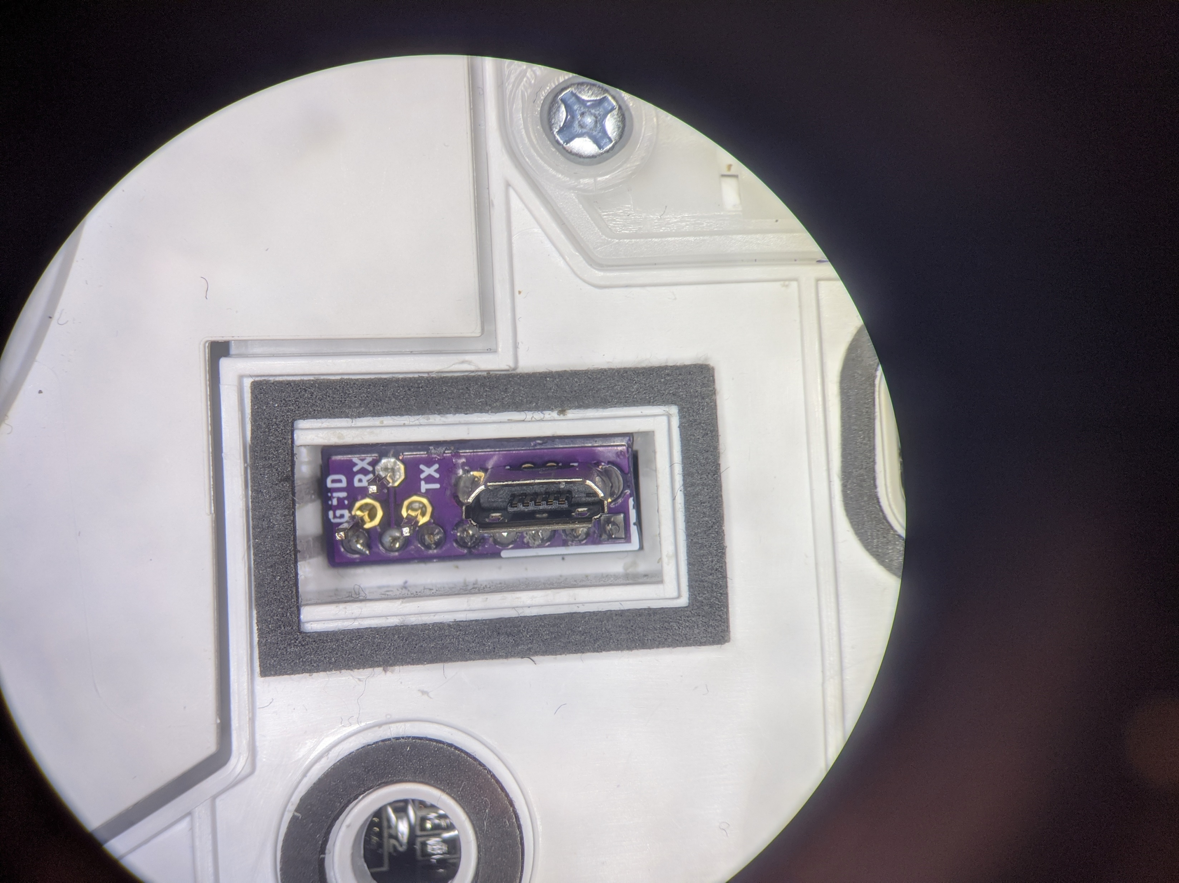
Usage of basic PCB
UART
USB
Marker
(front, right)
BOOT_SEL
Front
Front

Slide 21
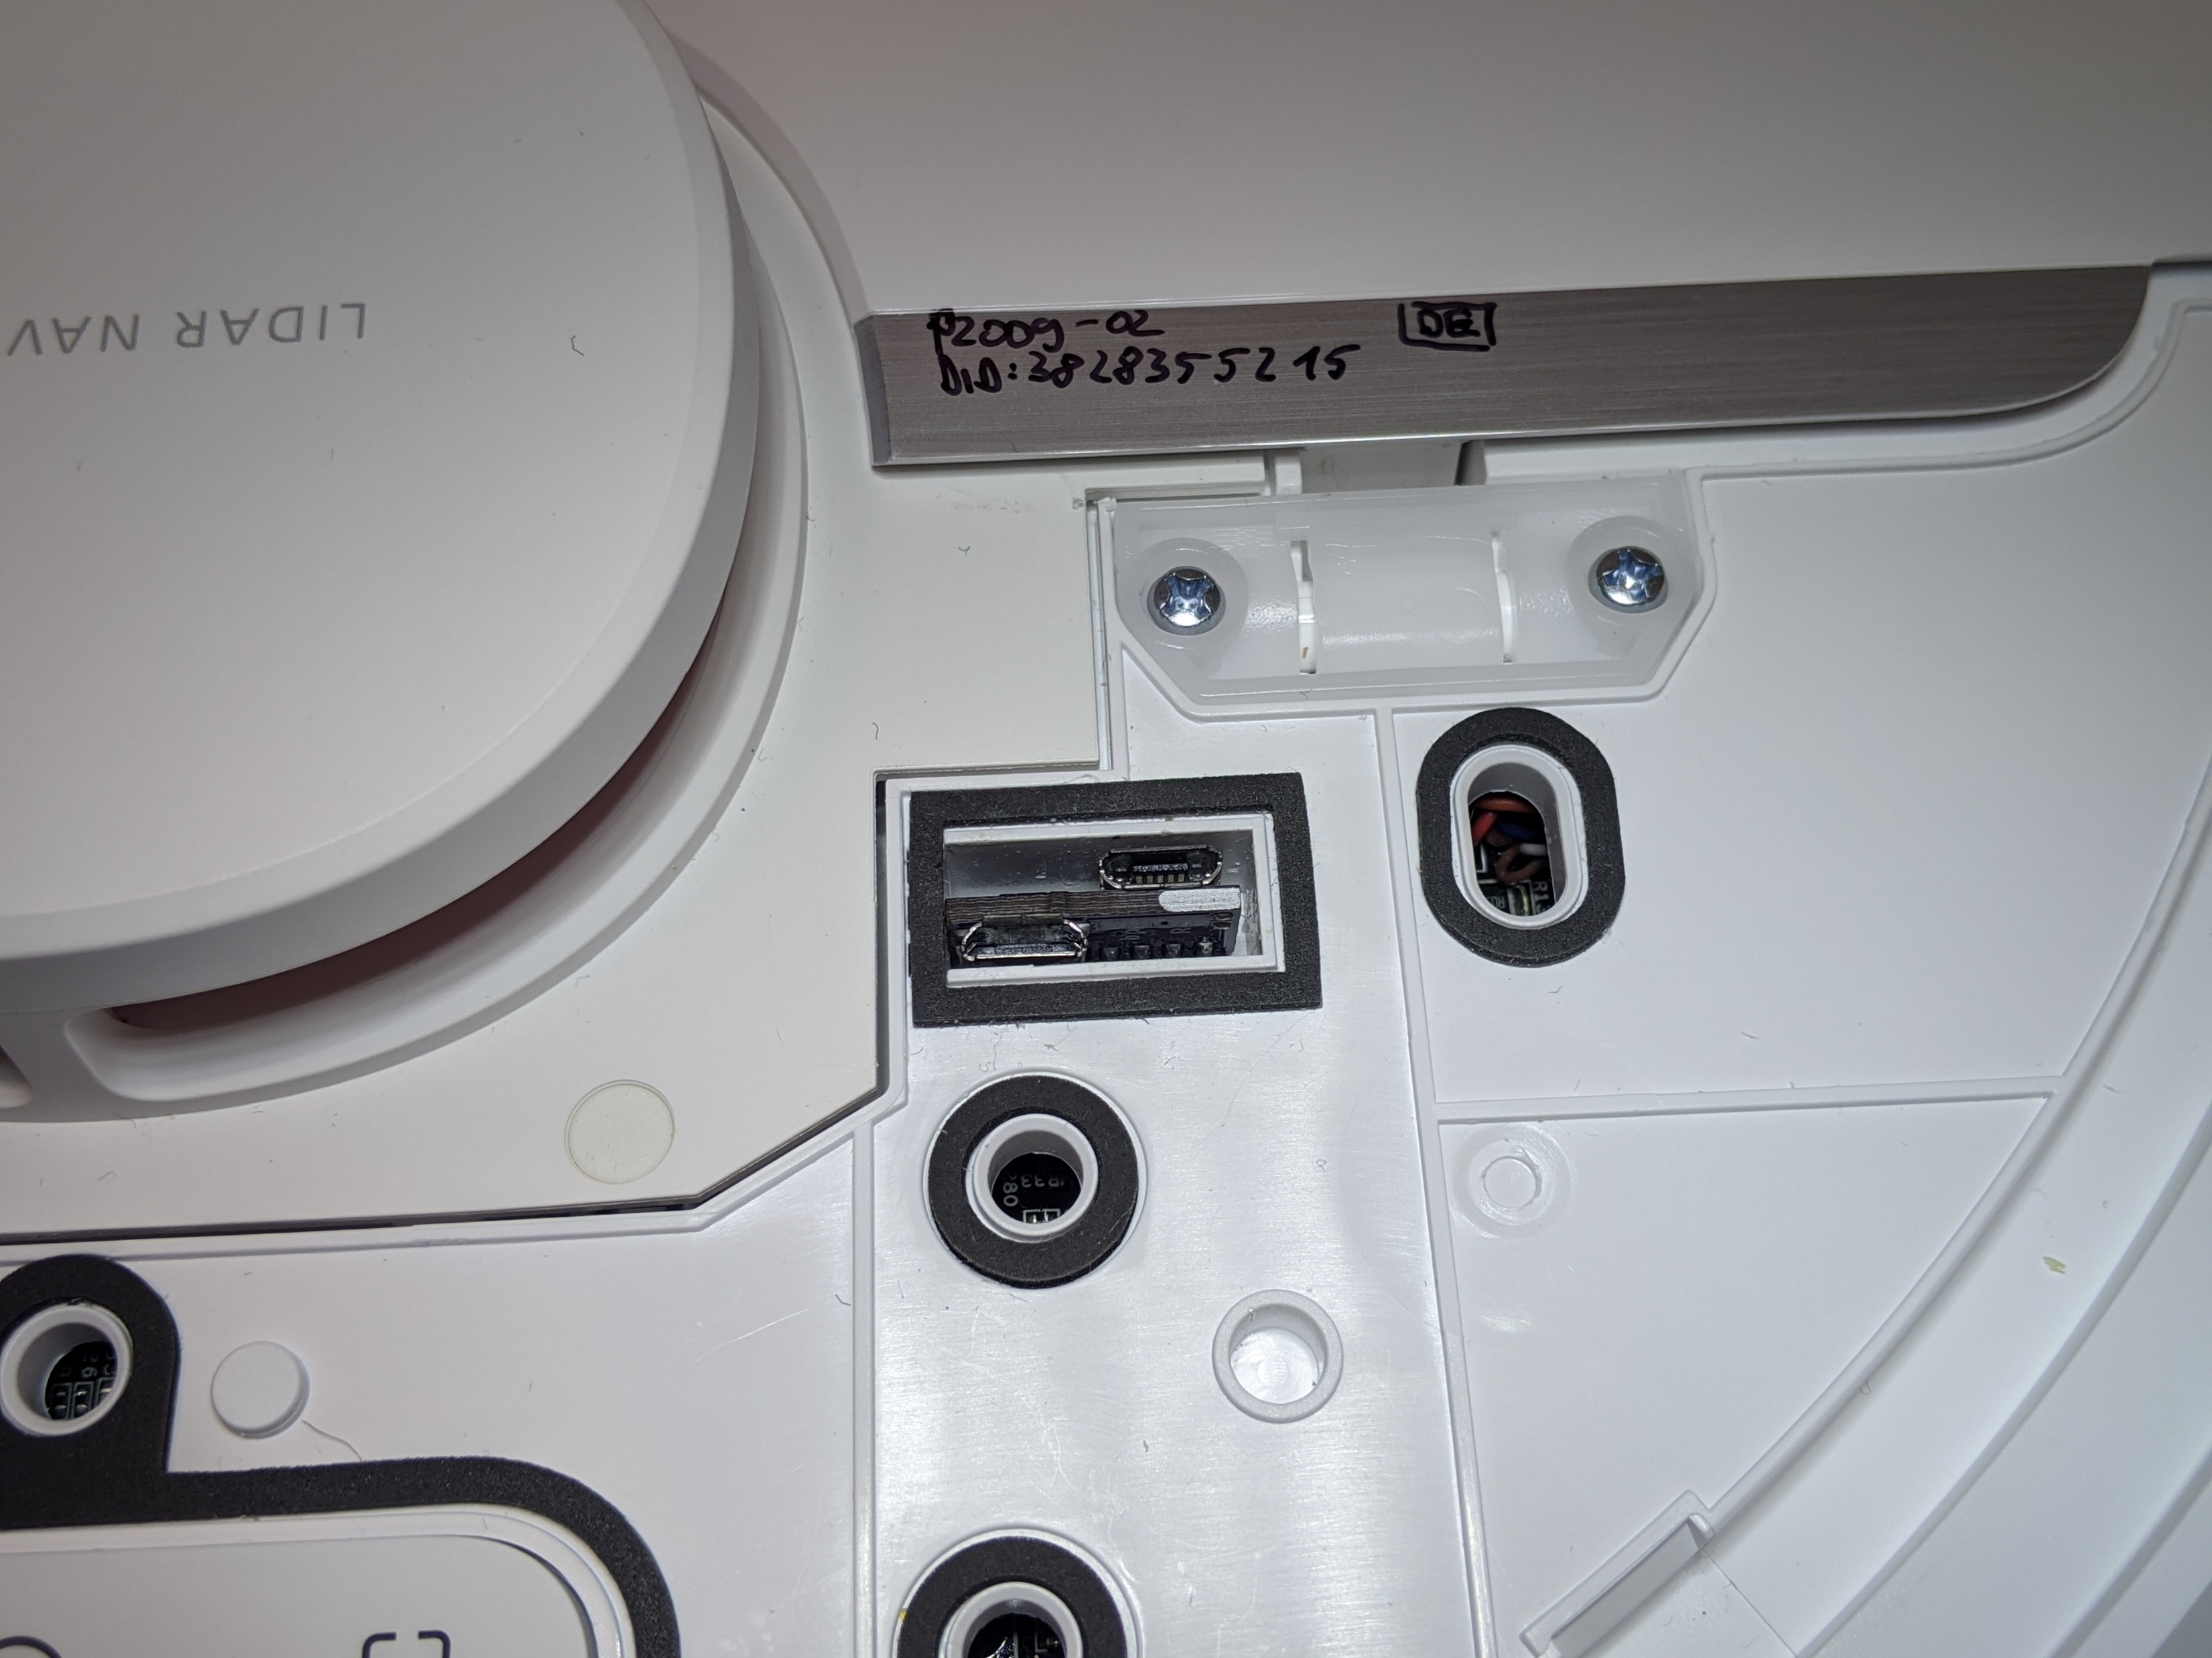
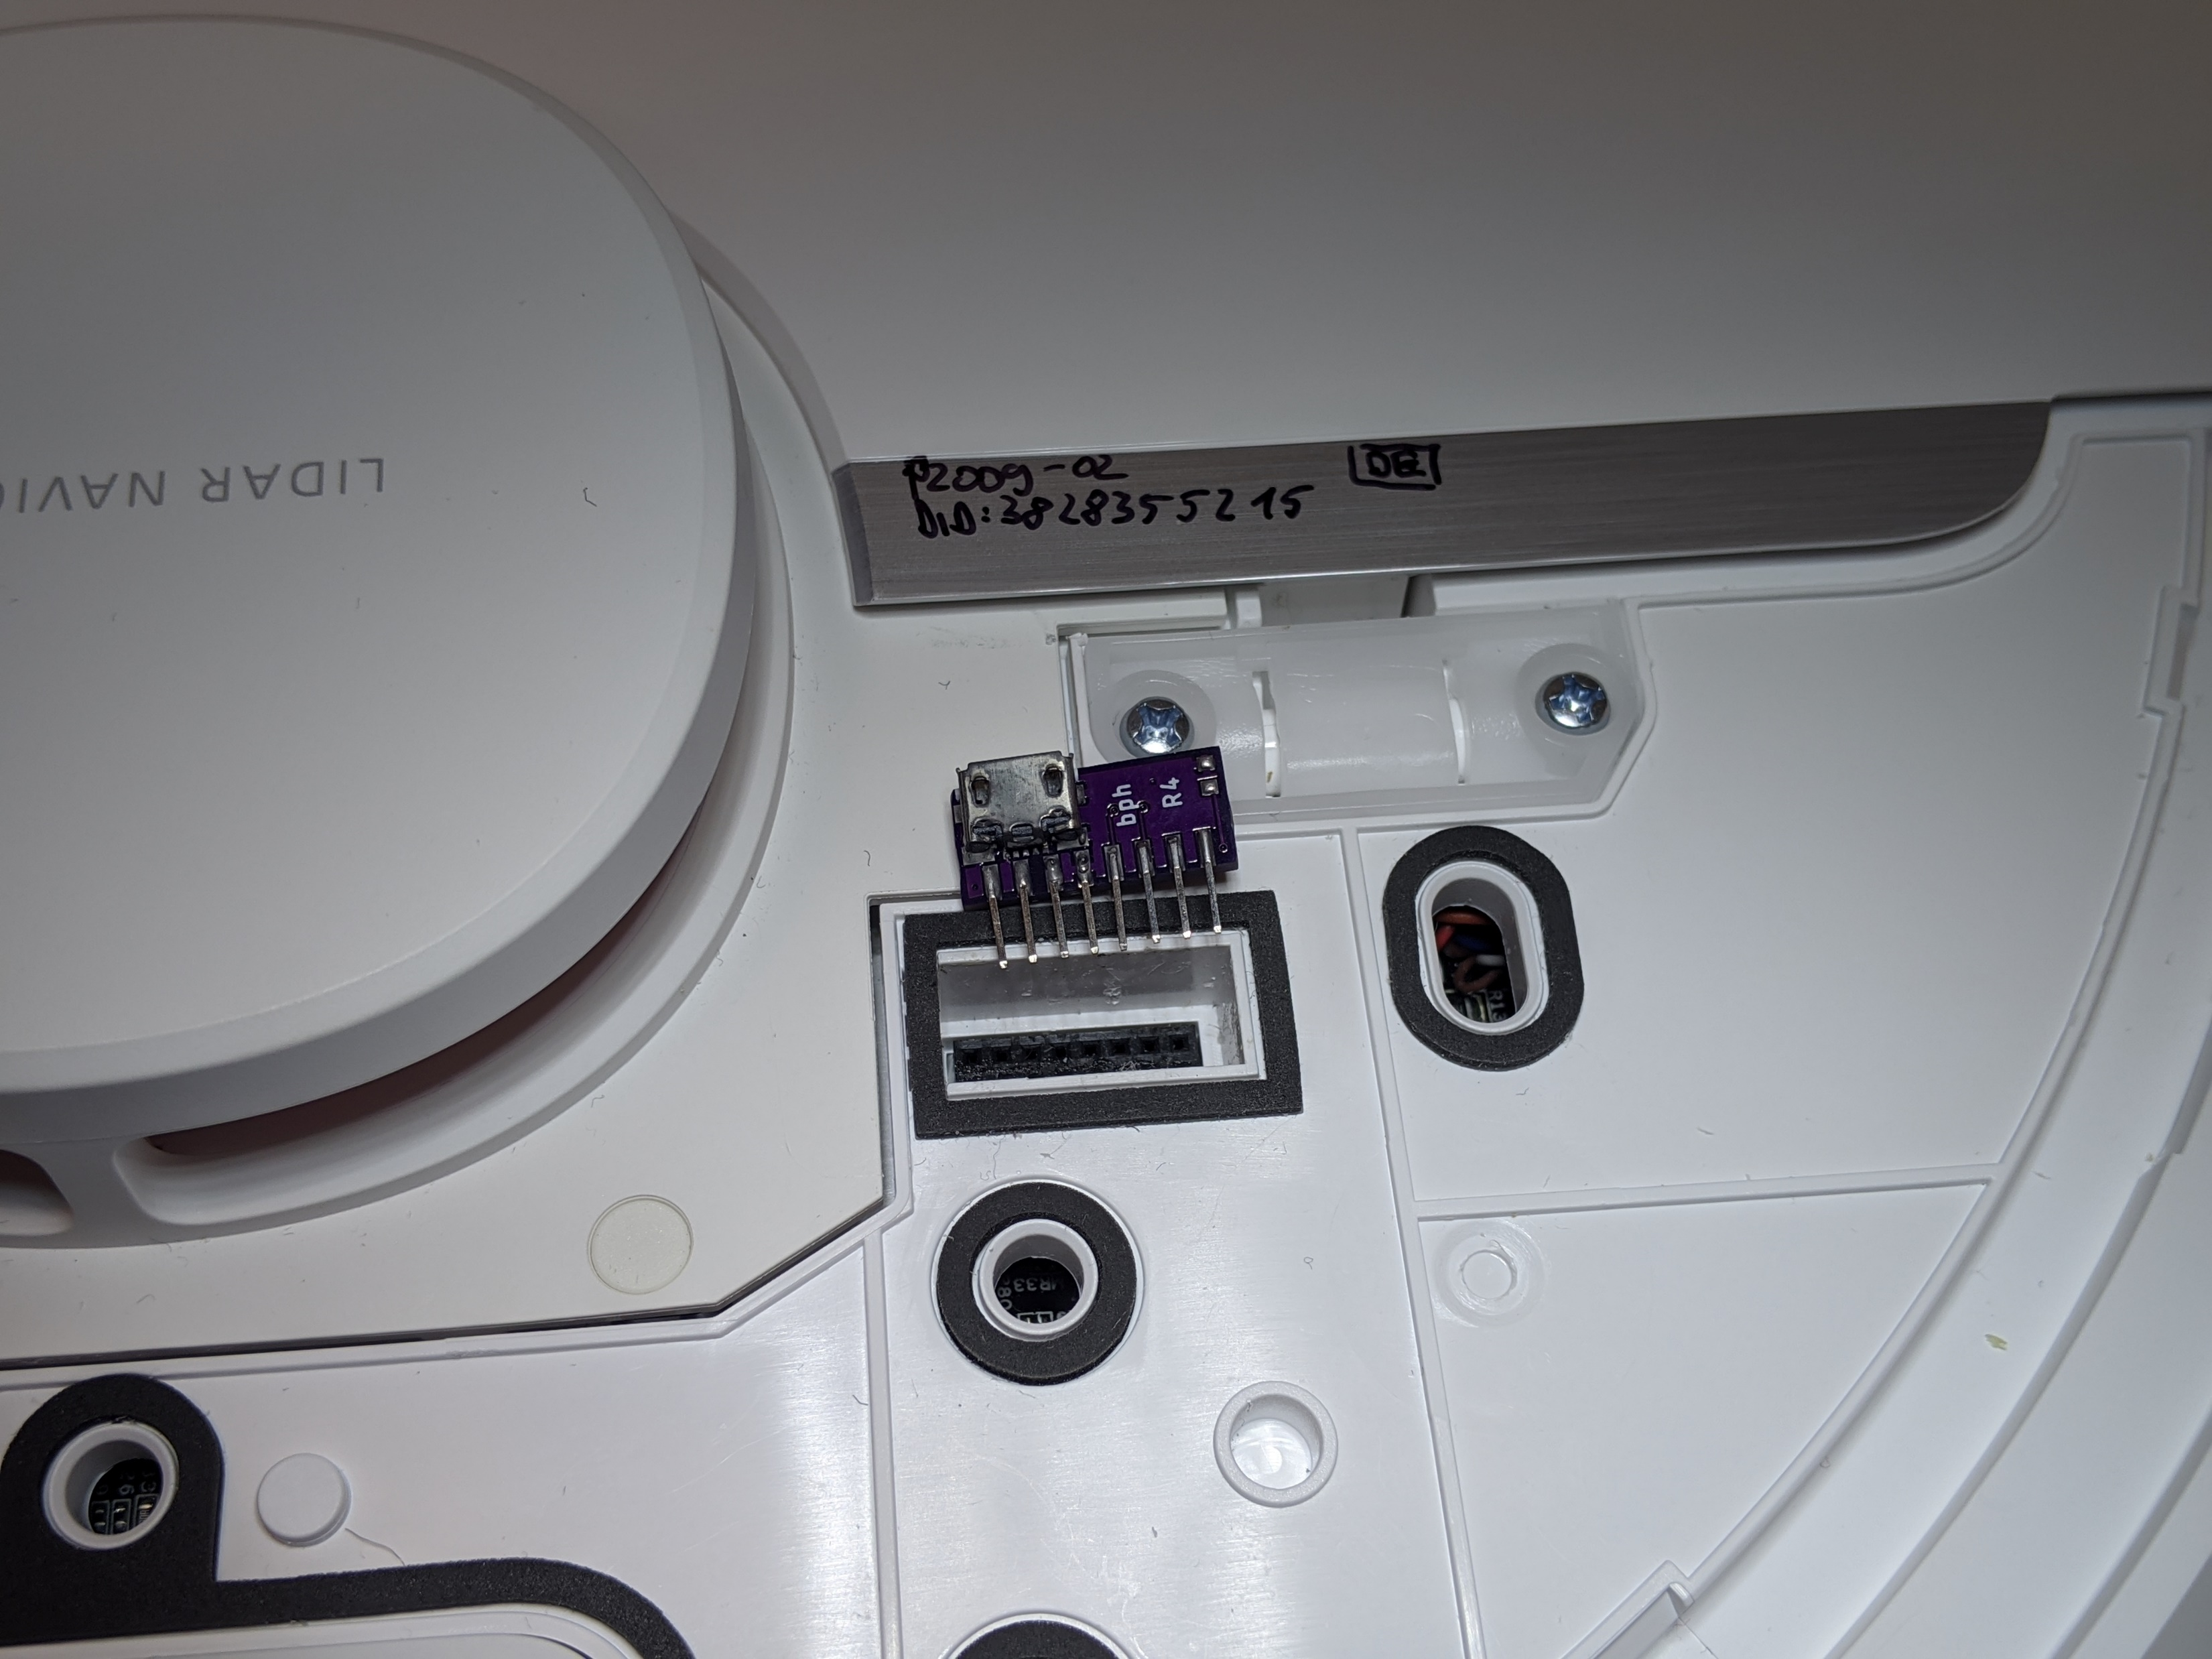
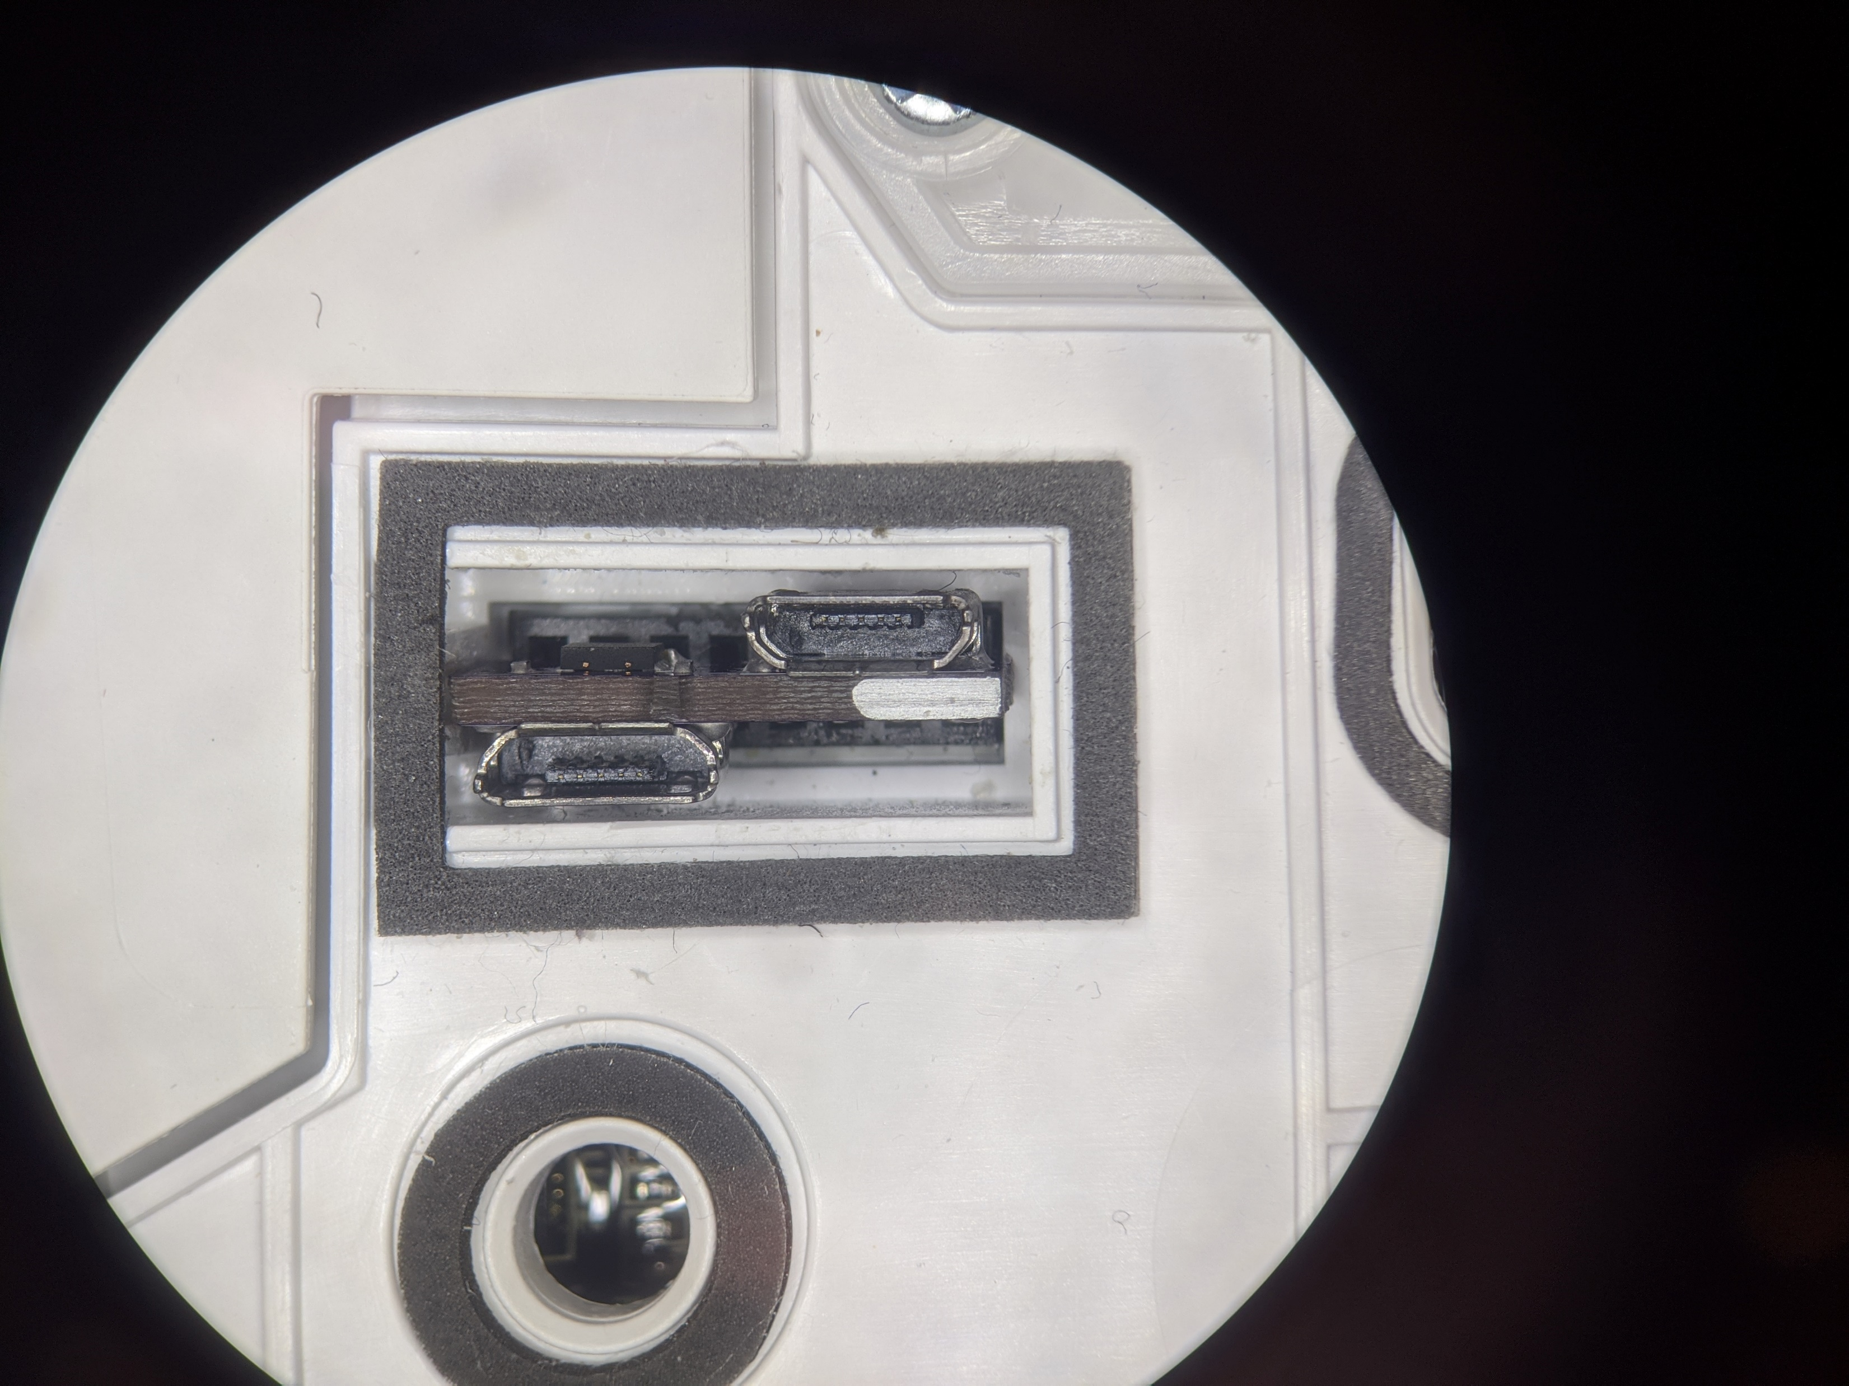
Usage of advanced PCB
USB
Marker
(needs to be on the right)
UART
BOOT_SEL
USB
Front
Front
UART
BOOT_SEL

Slide 22
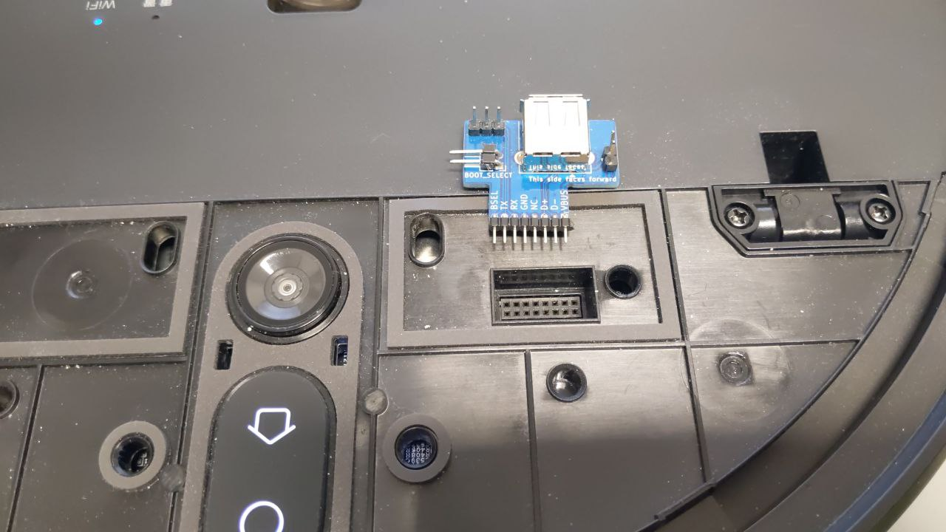
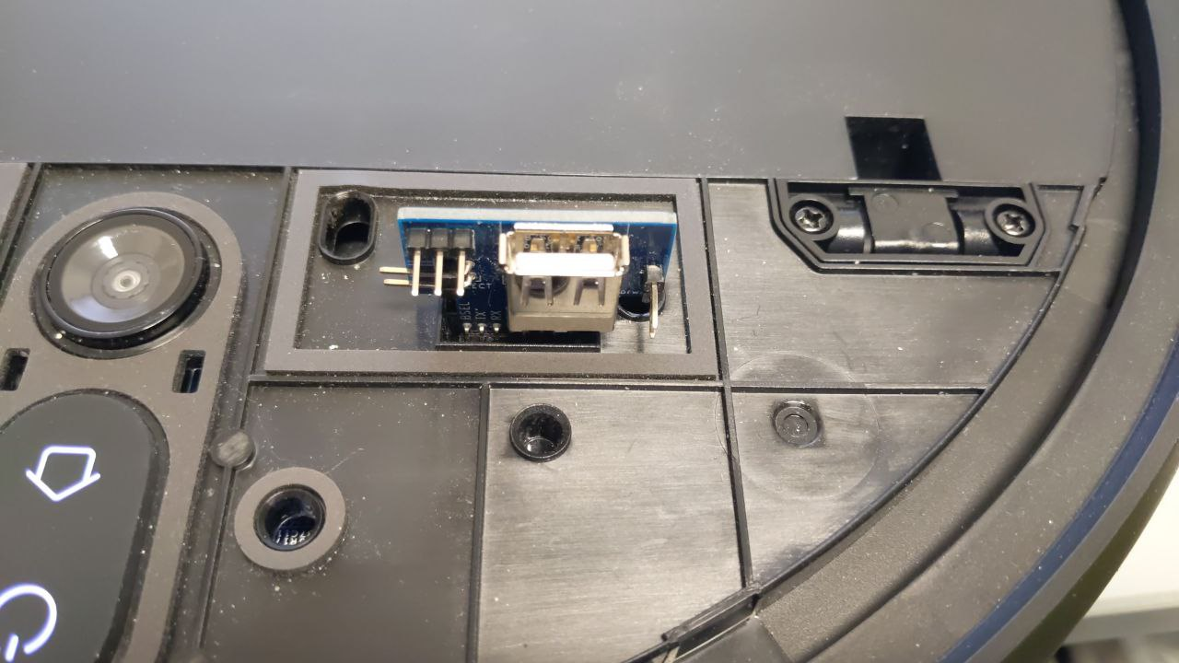
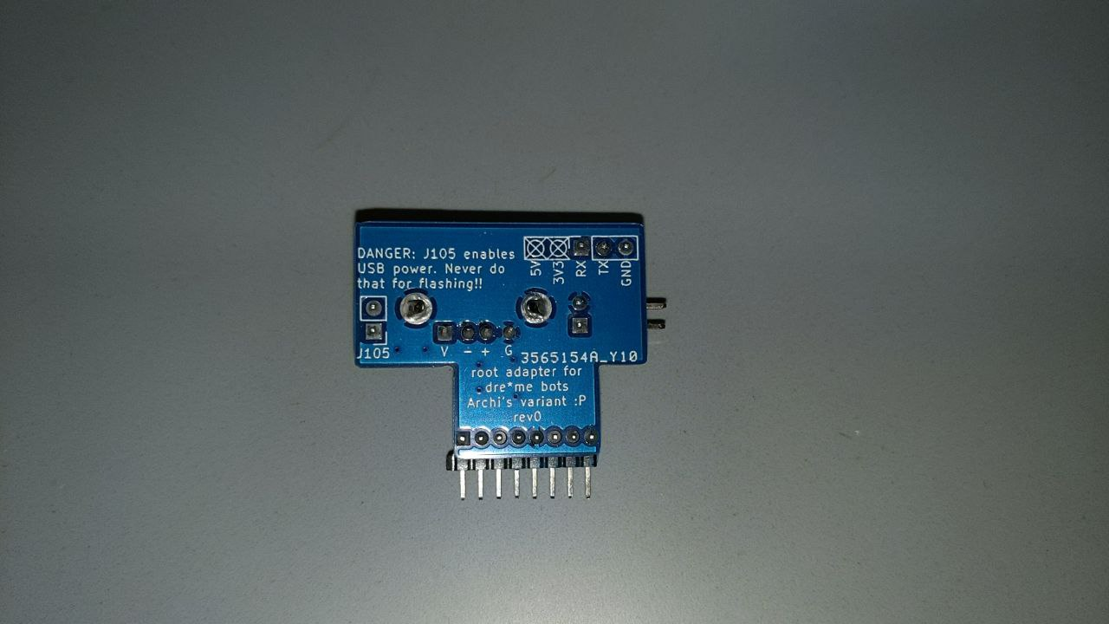
Usage of Archi’s PCB*
* Created by Telegram User Sebastian (@ArchimedesMP)
Front
Front

Slide 23
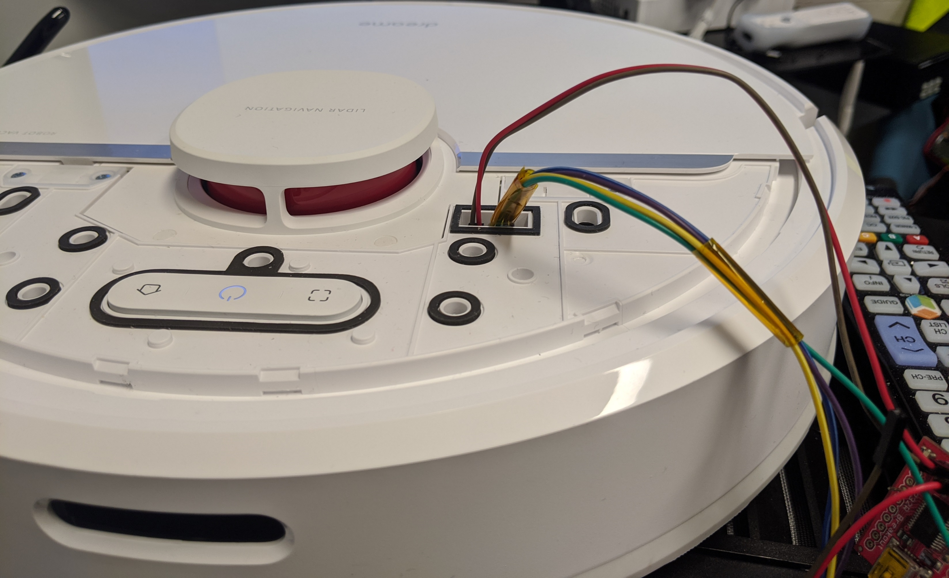
Connecting jumper wires (2mm pitch)

Slide 24
Reset Method

Slide 25
Reset Method
You can find all commands and steps in a text file here:
https://builder.dontvacuum.me/dreame/cmds-reset.txt
It is recommended that you copy+paste the commands (instead of typing them)
Background
The login shell is by default disabled on Dreame robots
The developers left a hidden function:
If reset button is pressed for <=1 second, a login shell is triggered
The root password is computed from the device serial number
This hidden function is patched in firmwares newer than 10.2021

Slide 26
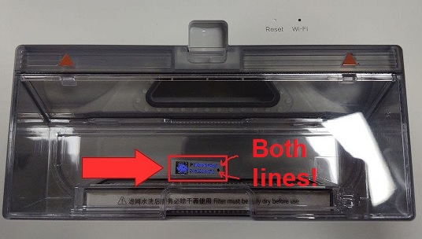
Reset Method Step 0
Compute the root password from the serial number
Under Linux:
'echo -n "P2009XXXXXXXXXXXXX" | md5sum | base64’ (where “P2….” is your serial)
The expected result is: 'Y2QxNjA4YjdhNWU1Y2RlNGQ3ODkzZjY4Yzk1MTVkOTAgIC0K’
Or use https://builder.dontvacuum.me/dreamepassword.php
Important:
Use the serial under the dustbin
Use both lines
Serial number under the robot differs!!

Slide 27
Reset Method Step 1
Get an adapter
Reminder: Works only on 1C/F9/D9
UART-USB adapter (3.3V, aka TTL adapter)
Typical chipsets:
FT232RL, FT232, PL2303TA or CP2102
Price ~10 USD/Euro
Notes:
To root the devices we need a few tools. We need screwdrivers to disassemble the device. I created a step by step video about how to do that. Its linked in the description.
Also we need a UART to USB adapter. You might find them under various names, like serial adapters or TTL adapters. The important thing here is that they support 3.3V logic level. Usually you can get them very cheaply over amazon or even in local stores.
For the actual connection, we need a few thing isolated copper wires or some breadboard jumper wires. Also some tape might be helpful.

Slide 28
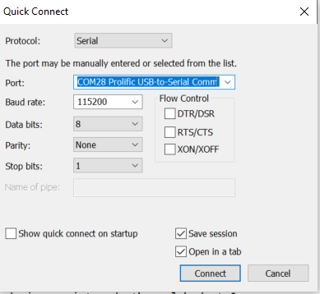
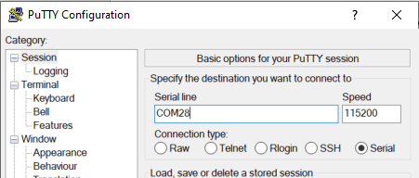
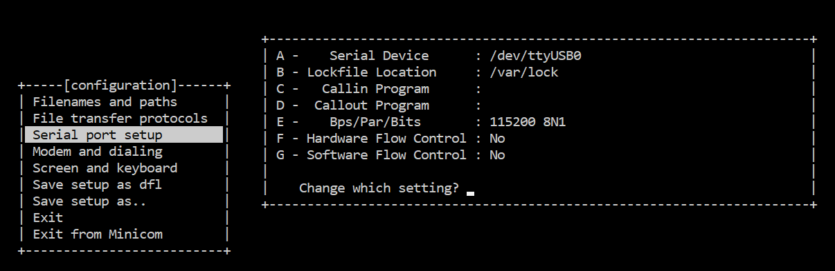
Reset Method Step 2a
Know where RX and TX on your adapter is
Configure your UART program
Baud: 115200
Flow control: off (!)
Test the settings without robot
Notes:
In this step, we want to setup your computer for the serial connection. You need to know where the RX and TX on your adapter is. For some adapters its marked, for some it’s a particular color of cable. In my case white was RX and green was TX. But don’t worry, you cant damage your robot, if you have it wrong.
Set your UART program to 115200 baud and disable flow control. This is very important. I have shown here a few example programs. Finally you want to test your settings. If you connect TX and RX of your adapter together and then type something, you should see an echo. This is what we call loopback.

Slide 29
Reset Method Step 2b
Power off the robot before proceeding
Remove it from the base station
Connect serial wires to PCB
Do not connect 5V (red cable)!
Test for correct connection
Press the power button for 3 seconds
You should see some output
If you don’t see anything, try to switch RX and TX
Notes:
In the next step, we connect to the robot. First, we need to connect the battery to the PCB. There is only one way to connect it, so you should not be able to do it wrong.
Then we connect the serial wires to the PCB. As mentioned before, you can use a MicroUSB cable to get ground. Connect TX and RX. Do not connect the red cable which is 5V. This is very important.
As a first test, that you did everything correctly, press the power button less than one second. It’s the middle button on the PCB. If you do that, you should see some text output from your robot. If you don’t see anything, then you might have mixed RX and TX or your connection is bad. If you see some cryptic text, your settings might be incorrect.

Slide 30
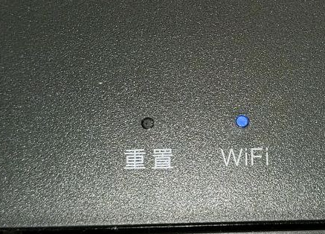
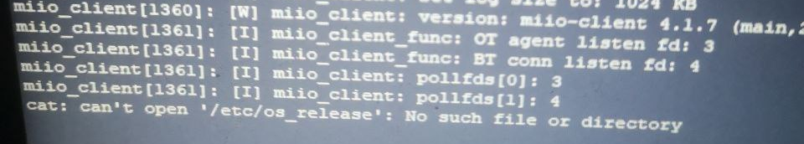
Reset Method Step 3
Wait for the robot to boot
Press reset button for <=1sec
The reset button is next to the WiFi LED
If you see something like “/etc/os_release”, your firmware might too new (or too old for 1C/F9/D9) ☹
If success full, you should see “pxxx_login:”
enter user “root”
enter password (that you computed in Step 0)
You should have a shell now

Slide 31
Reset Method Step 4
Check this document: https://builder.dontvacuum.me/dreame/cmds-reset.txt
Check the current installed version (check "fw_arm_ver"):
cat /etc/os-release
Run these commands to print the configuration (save output):
grep "" /mnt/private/ULI/factory/*
Run these commands to save the calibration (save output, outside of the robot):
grep "" /mnt/misc/*.json
grep "" /mnt/misc/*.yaml
cat /mnt/misc/*.txt
hexdump /mnt/misc/*.bin
Depending on your device model, some of the files might not exist for you. If you get file errors, it is totally fine and you can proceed.
Make sure that you copy the full output to a text file and save it

Slide 32
Reset Method Step 5
Check this document: https://builder.dontvacuum.me/dreame/cmds-reset.txt
Make copies of the firmware encryption keys (e.g., to restore the robot to a factory state)
cat /etc/OTA_Key_pub.pem
cat /etc/publickey.pem
Make sure that you save the output of the calibration and the encryption keys before proceeding
Run these commands to create binary backups:
mkdir -p /tmp/backup
tar -cvzf /tmp/backup/misc_backup.tgz -C /mnt/misc .
tar -cvzf /tmp/backup/factory.tgz -C /mnt/private/ULI/factory/ .
cp /tmp/backup/*.tgz /data/

Slide 33
Reset Method Step 6
Check this document: https://builder.dontvacuum.me/dreame/cmds-reset.txt
If the robot is already in your WiFi, skip this step
If the robot is still unprovisioned, you have 2 choices
Connect the robot temporarily to the WiFi
Use the command: wifi_cli -c "SSID" "password“
You must reset the WiFi after you installed the custom firmware, otherwise Valetudo will not work!
Connect your computer to the robot‘s WiFi, and run a local HTTP server on your computer
Example: use python http.server or SimpleHTTPServer*
* https://developer.mozilla.org/en-US/docs/Learn/Common_questions/set_up_a_local_testing_server
Depending on your device model and firmware version, this might not work

Slide 34
Reset Method Step 7
Check this document: https://builder.dontvacuum.me/dreame/cmds-reset.txt
Make sure that your robot is fully charged and back in its dock
Run this commands to download an install the rooted firmware:
cd /tmp
wget --no-check-certificate {url-of-firmware.tar.gz}
tar -xzvf {name-of-firmware.tar.gz}
./install.sh

Slide 35
UART Method
Only for 1C/F9/D9
Do not use this method if the Reset method works for you!

Slide 36
UART method
You can find all commands and steps in a text file here:
https://builder.dontvacuum.me/dreame/cmds.txt
It is recommended that you copy+paste the commands (instead of typing them)
Idea: Interrupt U-Boot, boot in single user mode, backup files
Limitation: works only on 1C/F9/D9
Power off the robot
Connect to UART (115200 baud, no flow control)
Power on the robot and keep key “s” pressed
Modify the command line and boot
Print files over UART
Install custom firmware

Slide 37
UART Method Step 1
Get an adapter
Reminder: Works only on 1C/F9/D9
UART-USB adapter (3.3V, aka TTL adapter)
Typical chipsets:
FT232RL, FT232, PL2303TA or CP2102
Price ~10 USD/Euro
Notes:
To root the devices we need a few tools. We need screwdrivers to disassemble the device. I created a step by step video about how to do that. Its linked in the description.
Also we need a UART to USB adapter. You might find them under various names, like serial adapters or TTL adapters. The important thing here is that they support 3.3V logic level. Usually you can get them very cheaply over amazon or even in local stores.
For the actual connection, we need a few thing isolated copper wires or some breadboard jumper wires. Also some tape might be helpful.

Slide 38
UART Method Step 2a
Know where RX and TX on your adapter is
Configure your UART program
Baud: 115200
Flow control: off (!)
Test the settings without robot
Notes:
In this step, we want to setup your computer for the serial connection. You need to know where the RX and TX on your adapter is. For some adapters its marked, for some it’s a particular color of cable. In my case white was RX and green was TX. But don’t worry, you cant damage your robot, if you have it wrong.
Set your UART program to 115200 baud and disable flow control. This is very important. I have shown here a few example programs. Finally you want to test your settings. If you connect TX and RX of your adapter together and then type something, you should see an echo. This is what we call loopback.

Slide 39
UART Method Step 2b
Connect serial wires to PCB
Do not connect 5V (red cable)!
Test for correct connection
Press middle button (<1s)
You should see some output
Notes:
In the next step, we connect to the robot. First, we need to connect the battery to the PCB. There is only one way to connect it, so you should not be able to do it wrong.
Then we connect the serial wires to the PCB. As mentioned before, you can use a MicroUSB cable to get ground. Connect TX and RX. Do not connect the red cable which is 5V. This is very important.
As a first test, that you did everything correctly, press the power button less than one second. It’s the middle button on the PCB. If you do that, you should see some text output from your robot. If you don’t see anything, then you might have mixed RX and TX or your connection is bad. If you see some cryptic text, your settings might be incorrect.

Slide 40
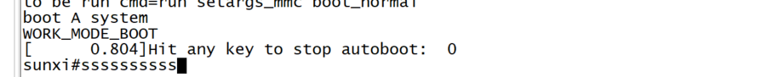
UART Method Step 3
Inside the terminal program
Hold “s” key on your keyboard
At the same time: Press middle button for 3 seconds
We want to see this:
Notes:
Now comes the important part. Press and hold the S key on your computer. Then at the same time press the middle button for 3 seconds. You should see some text and at some point you should have the prompt of the bootloader.
If you don’t see that prompt and you see Ubuntu booting instead, you might have forgotten to disable flow control in your serial terminal.

Slide 41
UART Method Step 4a
In the U-Boot shell run this commands:
setenv init /bin/sh
setenv boot_partition boot1
run setargs_nand
run boot_normal
Your robot should boot and present you a shell

Slide 42
UART Method Step 4b
After the system booted, run these commands (copy+paste from the cmds.txt):
/etc/init.d/sysconfig.sh
echo V > /dev/watchdog
/etc/init.d/mount_private.sh
/etc/init.d/mount_misc.sh
mount /tmp
mkdir /tmp/fakeetc
cp -R /etc/* /tmp/fakeetc
mount --bind /tmp/fakeetc /etc
echo >> /tmp/fakeetc/inittab
echo '::respawn:-/bin/sh' >> /tmp/fakeetc/inittab
exec init

Slide 43
UART Method Step 4c
Run these commands to print the configuration (save output):
grep "" /mnt/private/ULI/factory/*
Run these commands to save the calibration (save output):
grep "" /mnt/misc/*.json
grep "" /mnt/misc/*.yaml
cat /mnt/misc/*.txt
hexdump /mnt/misc/*.bin
Some files might not exist on your device. That is normal.
Make sure that you copy the full output to a text file and save it

Slide 44
UART Method Step 5
Check this document: https://builder.dontvacuum.me/dreame/cmds.txt
Make copies of the firmware encryption keys (e.g., to restore the robot to a factory state)
cat /etc/OTA_Key_pub.pem
cat /etc/publickey.pem
Make sure that you save the output of the calibration and the encryption keys before proceeding
Run these commands to create binary backups:
mkdir -p /tmp/backup
tar -cvzf /tmp/backup/misc_backup.tgz -C /mnt/misc .
tar -cvzf /tmp/backup/factory.tgz -C /mnt/private/ULI/factory/ .
cp /tmp/backup/*.tgz /data/

Slide 45
UART Method Step 6
Check this document: https://builder.dontvacuum.me/dreame/cmds.txt
If the robot is already in your WiFi, skip this step
If the robot is still unprovisioned, you have 2 choices
Connect the robot temporarily to the WiFi
Use the command: wifi_cli -c "SSID" "password“
You must reset the WiFi after you installed the custom firmware, otherwise Valetudo will not work!
Connect your computer to the robot‘s WiFi, and run a local HTTP server on your computer
Example: use python http.server or SimpleHTTPServer*
* https://developer.mozilla.org/en-US/docs/Learn/Common_questions/set_up_a_local_testing_server
Depending on your device model and firmware version, this might not work

Slide 46
UART Method Step 7
Check this document: https://builder.dontvacuum.me/dreame/cmds.txt
Make sure that your robot is fully charged and back in its dock
Run this commands to download an install the rooted firmware:
cd /tmp
wget --no-check-certificate {url-of-firmware.tar.gz}
tar -xzvf {name-of-firmware.tar.gz}
./install.sh

Slide 47
Livesuit/FEL rooting
This method is our fallback method in case the other methods do not work. There is more risk involved. Before you use it, please ask us.

Slide 48
For 1C/F9/D9 only: DO NOT PROCEED if you do not have a backup of the configuration and calibration!! (check the method at the end of this pdf document)
Please report any issues directly (e.g. misflash, non-booting, etc)

Slide 49
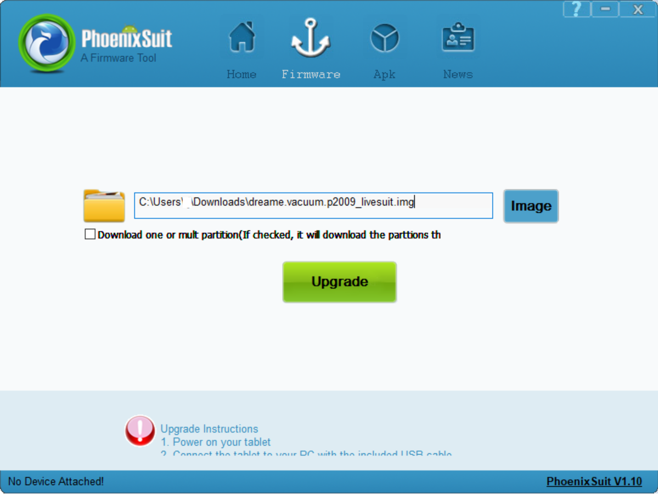
Root Step 1
Make sure that the robot is not connected over USB
Open Phoenixsuit and select image

Slide 50
Root Step 2
Boot the Robot in FEL mode
Connect MicroUSB to your computer (no USB hub, preferred USB 2.0 port)
Connect BOOT_SEL to GND
Use jumper wire (see 2a)
Basic adapter (see 2b)
Advanced adapter (see 2c)
Press the power button for 3 seconds
USB device should show up on your computer
You might need to install the Phoenixsuit drivers located in “Drivers/AW_Driver”
(via Device Manager -> Unknown Device -> Update drivers)
If that does not work, download it here: https://builder.dontvacuum.me/usbdriver.zip

Slide 51
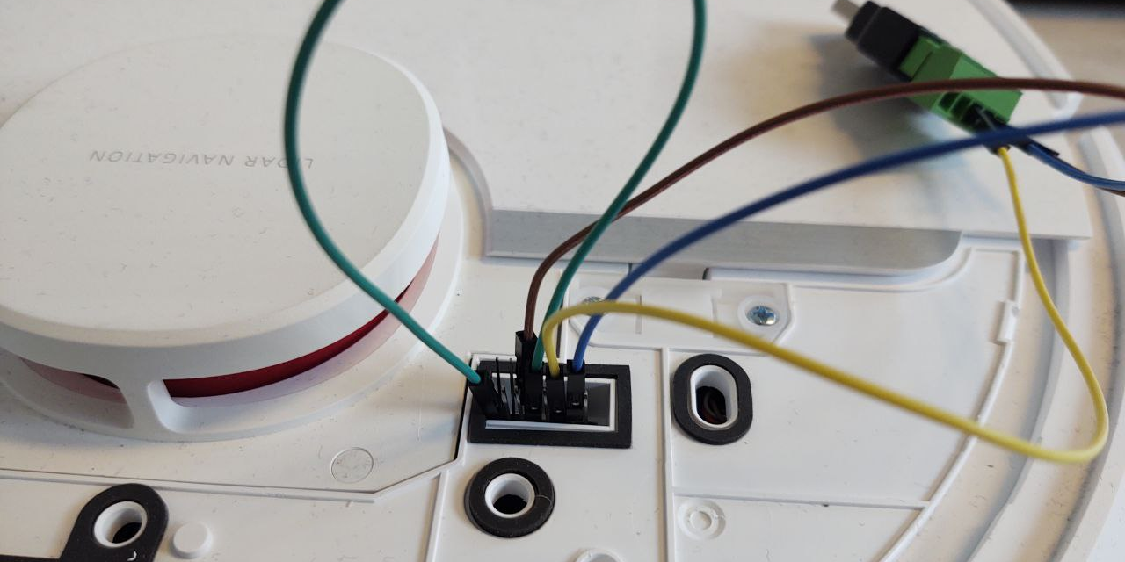
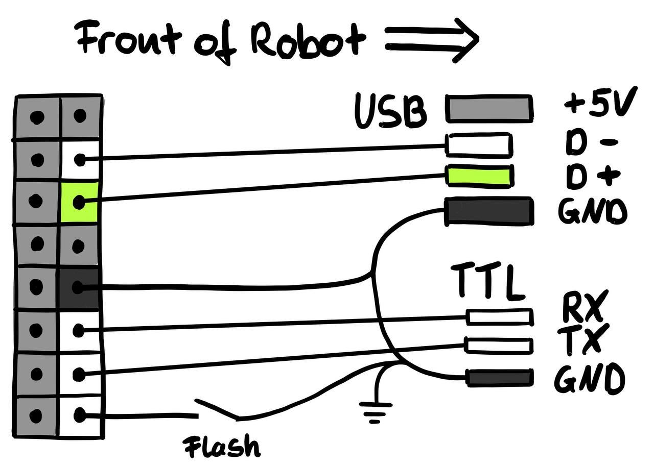
Root Step 2a
Jumper wires: Ideally you have 2mm headers
Make sure that the USB connection stays stable before you trigger the update (check the Windows Device Manager)
2.54 pitch jumper cables might fit but can cause issues

Slide 52
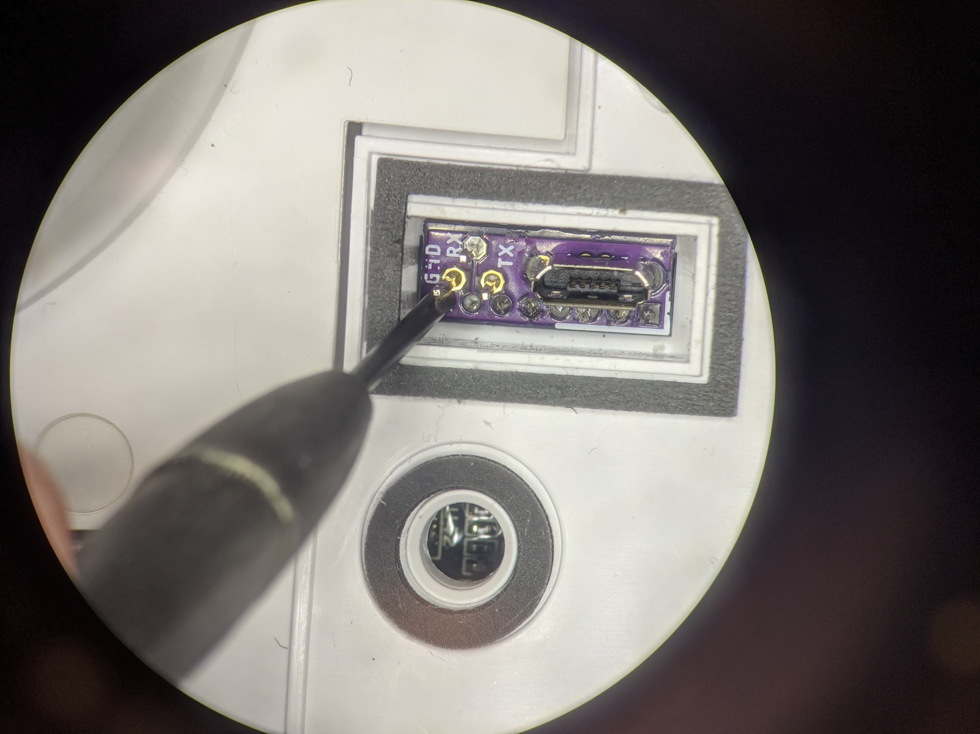
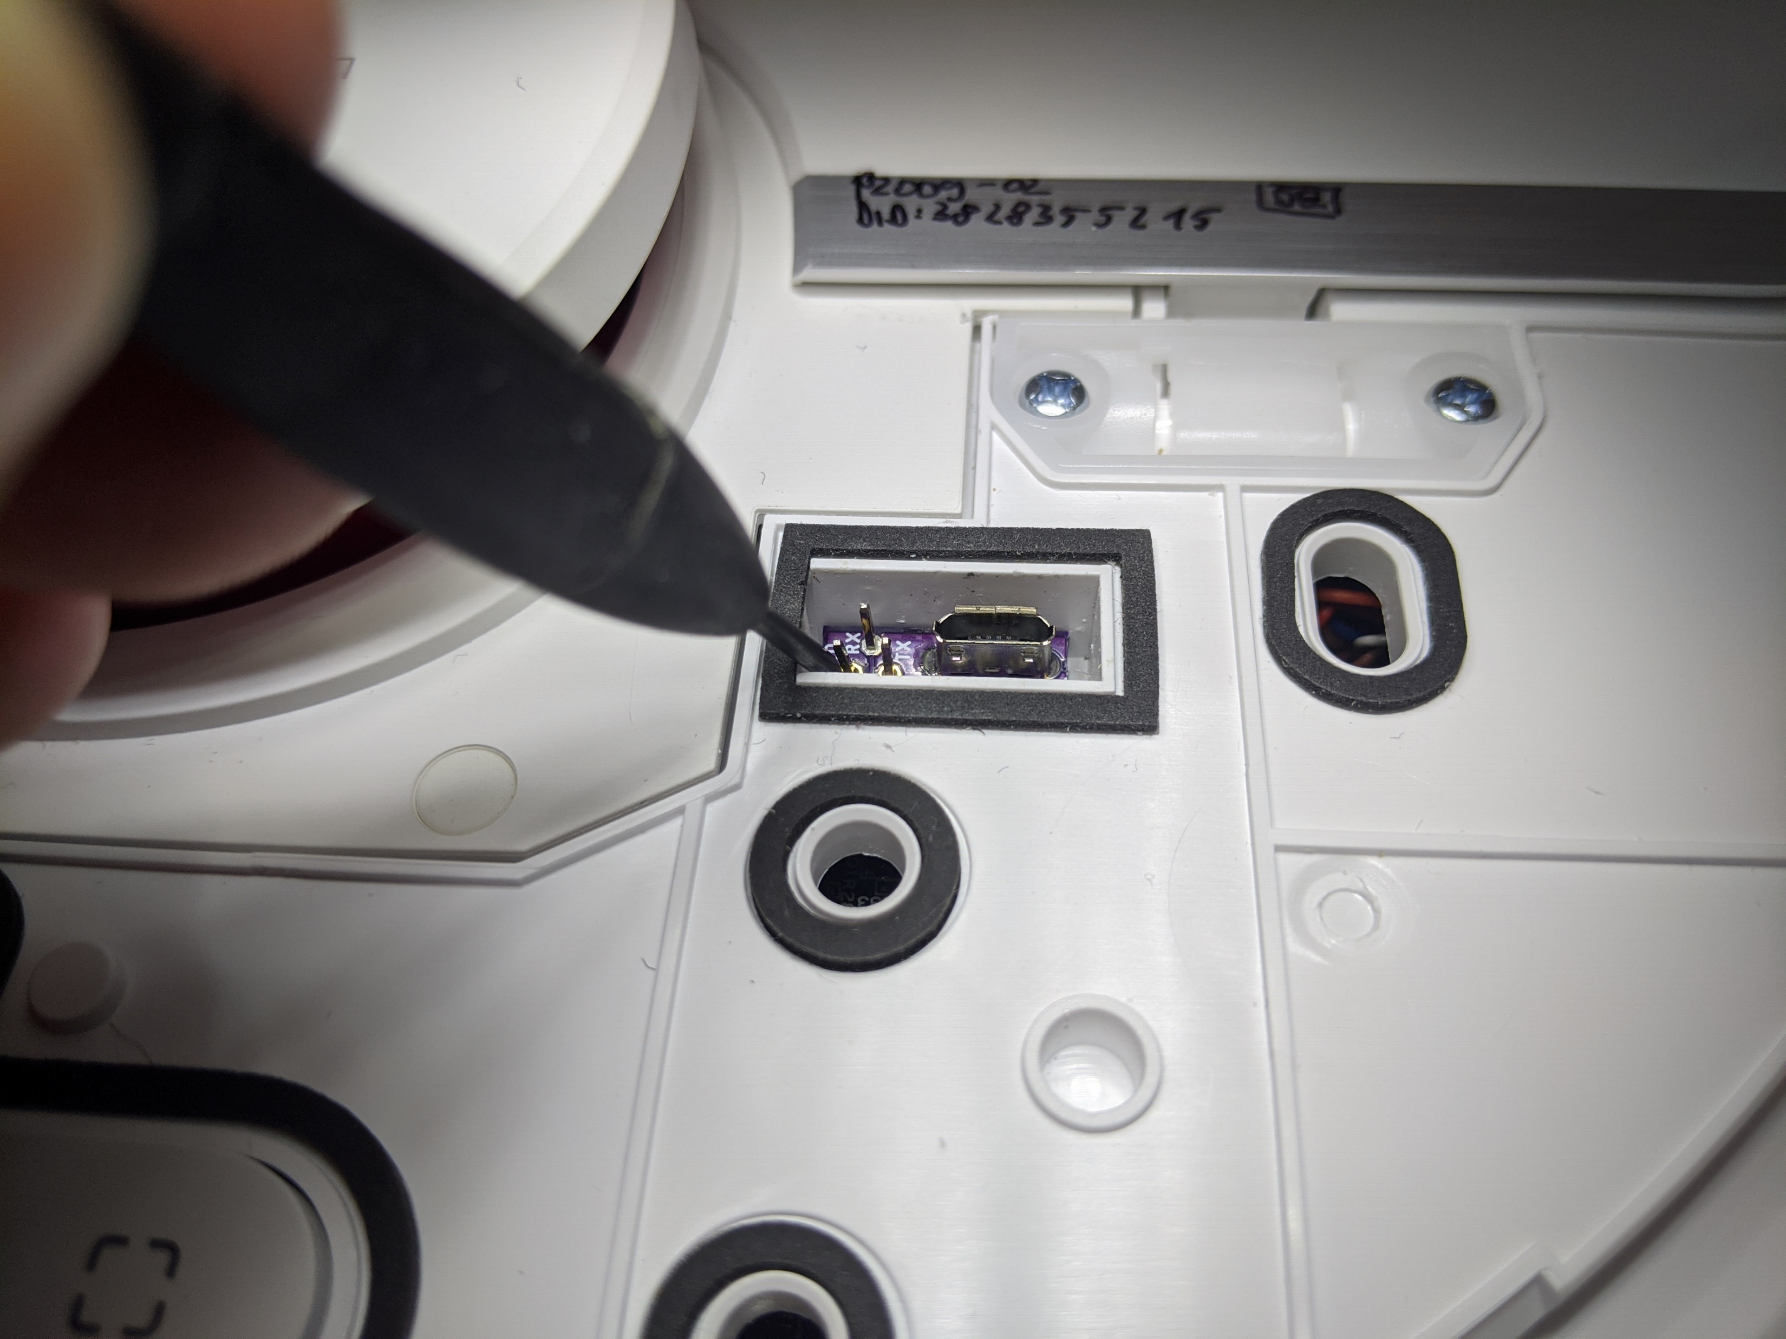
Root Step 2b
Basic PCB: Short the left pin to GND (e.g. with screwdriver)

Slide 53
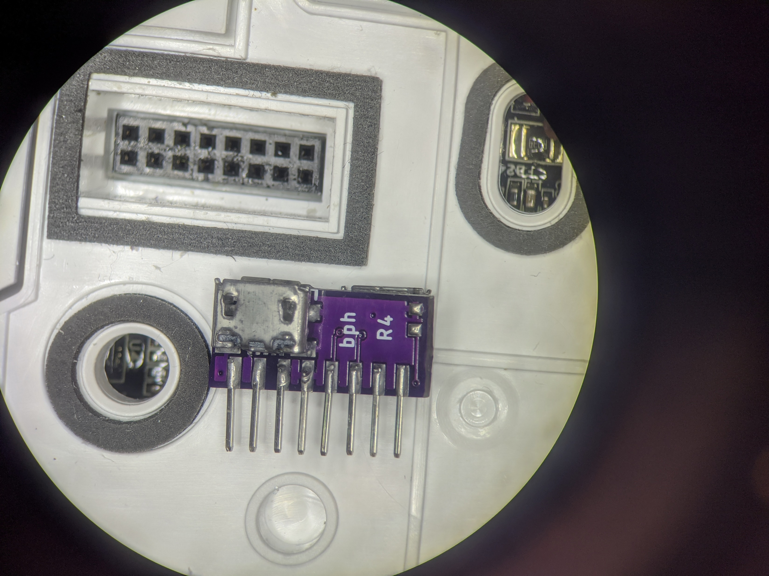
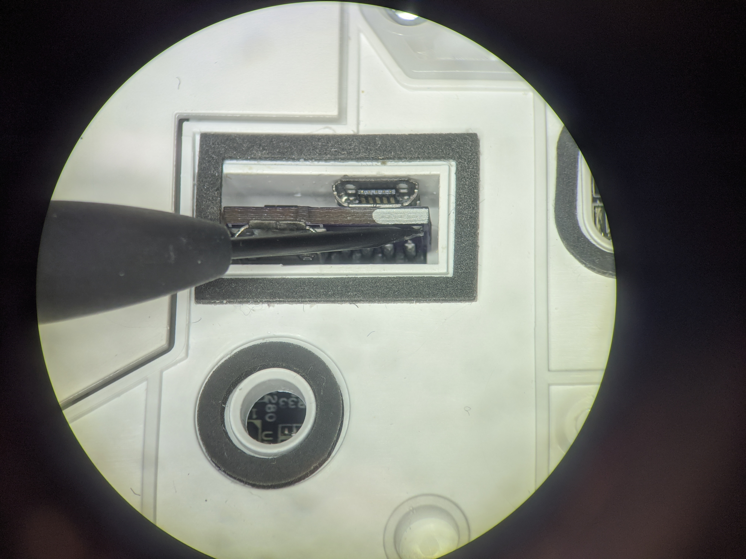
Root Step 2c
Advanced PCB: Short BOOT_SEL pads
BOOT_SEL

Slide 54
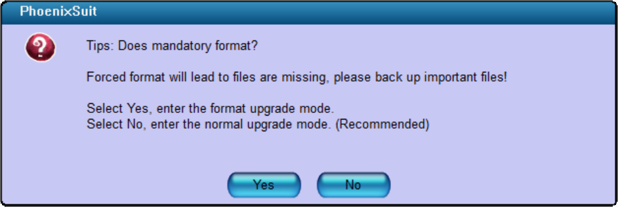
Root Step 3
Disconnect BOOT_SEL before proceeding
In Phoenixsuit
Click on Update
If asked about mandatory format, select “No” !
Wait for Update to finish

Slide 55
Root Step 3 Trouble shooting
Do not use USB hubs
Use only USB 2.0 connections
If the device is detected initially, but disappears:
Try to use a different USB port
If you use VMs: Make sure that the USB filter is correct

Slide 56
Firmware customization

Slide 57
You have now installed a custom firmware ;)

Slide 58
Customization of firmware
The firmware builder adds to hooks to the start process
/data/_root_sysconfig.sh (gets executed early)
/data/_root_postboot.sh (gets executed after boot)
At each boot we check for the presence of the custom files
Safety measurement: In case something goes wrong, a factory reset will delete this files
An example file can be found in /misc

Slide 59
Valetudo installation
Download valetudo binary to /data:
https://github.com/Hypfer/Valetudo/releases
Device dependent (check our website):
1C, F9, D9: valetudo-armv7-lowmem
1T, L10 Pro: valetudo-aarch64
“wget https://github.com/Hypfer/Valetudo/releases/latest/download/valetudo-armv7-lowmem -O /data/valetudo”
Make valetudo executable
“chmod +x /data/valetudo”
Enable boot script
“cp /misc/_root_postboot.sh.tpl /data/_root_postboot.sh”
“chmod +x /data/_root_postboot.sh”
Reboot
You might need to add “--no-check-certificate” if wget fails
Check https://builder.dontvacuum.me/dreame/cmds.txt for a copy-pastable command list

Slide 60
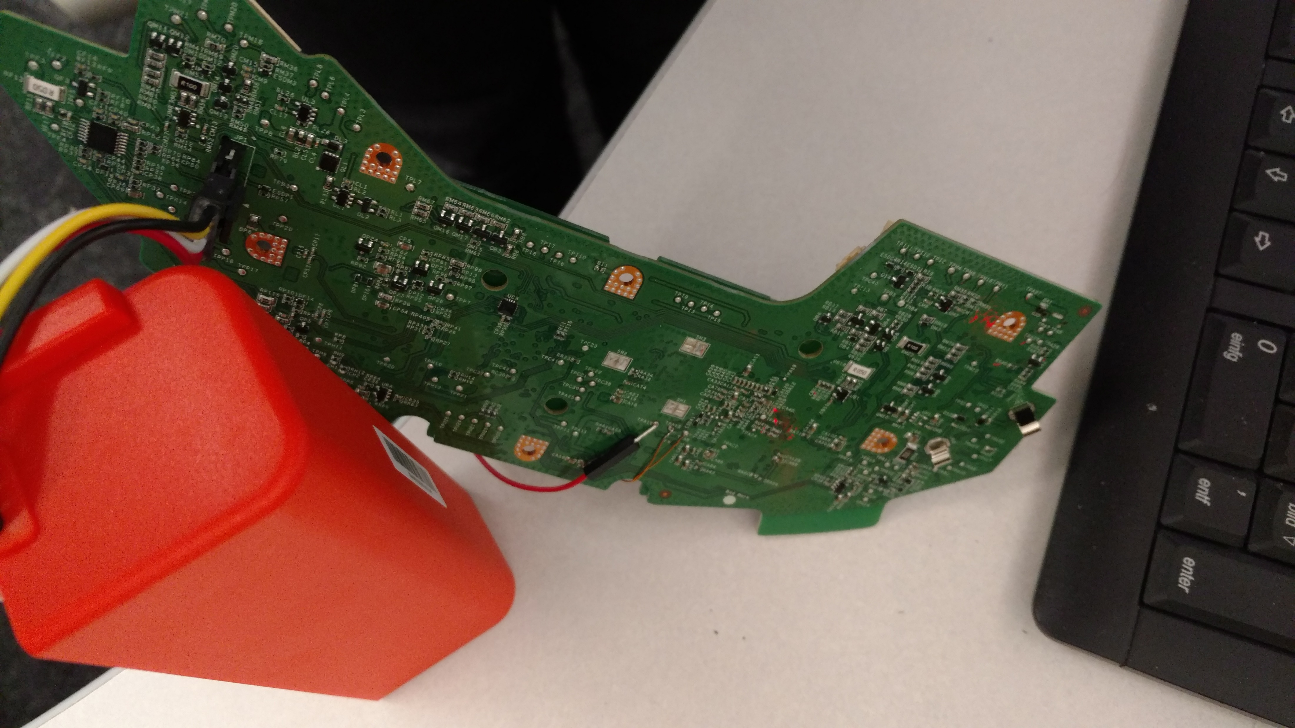

Thank you for watching!
@dgi_DE
Website: dontvacuum.me

Slide 61
Backups via UART
Only relevant if you have a 1C/F9/D9 and Reset method does not work

Slide 62
Backup of configuration and calibration
Background: If flashing the custom firmware fails, the robot might delete the configuration and calibration files
Idea: Interrupt U-Boot, boot in single user mode, backup files
Limitation: works only on 1C/F9/D9
Power off the robot
Connect to UART (115200 baud, no flow control)
Power on the robot and keep key “s” pressed
Modify the command line and boot
Print files over UART

Slide 63
Backup Step 1
Get an adapter
Reminder: Works only on 1C/F9/D9
UART-USB adapter (3.3V, aka TTL adapter)
Typical chipsets:
FT232RL, FT232, PL2303TA or CP2102
Price ~10 USD/Euro
Notes:
To root the devices we need a few tools. We need screwdrivers to disassemble the device. I created a step by step video about how to do that. Its linked in the description.
Also we need a UART to USB adapter. You might find them under various names, like serial adapters or TTL adapters. The important thing here is that they support 3.3V logic level. Usually you can get them very cheaply over amazon or even in local stores.
For the actual connection, we need a few thing isolated copper wires or some breadboard jumper wires. Also some tape might be helpful.

Slide 64
Backup Step 2a
Know where RX and TX on your adapter is
Configure your UART program
Baud: 115200
Flow control: off (!)
Test the settings without robot
Notes:
In this step, we want to setup your computer for the serial connection. You need to know where the RX and TX on your adapter is. For some adapters its marked, for some it’s a particular color of cable. In my case white was RX and green was TX. But don’t worry, you cant damage your robot, if you have it wrong.
Set your UART program to 115200 baud and disable flow control. This is very important. I have shown here a few example programs. Finally you want to test your settings. If you connect TX and RX of your adapter together and then type something, you should see an echo. This is what we call loopback.

Slide 65
Backup Step 2b
Connect serial wires to PCB
Do not connect 5V (red cable)!
Test for correct connection
Press middle button (<1s)
You should see some output
Notes:
In the next step, we connect to the robot. First, we need to connect the battery to the PCB. There is only one way to connect it, so you should not be able to do it wrong.
Then we connect the serial wires to the PCB. As mentioned before, you can use a MicroUSB cable to get ground. Connect TX and RX. Do not connect the red cable which is 5V. This is very important.
As a first test, that you did everything correctly, press the power button less than one second. It’s the middle button on the PCB. If you do that, you should see some text output from your robot. If you don’t see anything, then you might have mixed RX and TX or your connection is bad. If you see some cryptic text, your settings might be incorrect.

Slide 66
Backup Step 3
Inside the terminal program
Hold “s” key on your keyboard
At the same time: Press middle button for 3 seconds
We want to see this:
Notes:
Now comes the important part. Press and hold the S key on your computer. Then at the same time press the middle button for 3 seconds. You should see some text and at some point you should have the prompt of the bootloader.
If you don’t see that prompt and you see Ubuntu booting instead, you might have forgotten to disable flow control in your serial terminal.

Slide 67
Backup Step 4a
In the U-Boot shell run this commands:
setenv init /bin/sh
setenv boot_partition boot1
run setargs_nand
run boot_normal
Your robot should boot and present you a shell
Check https://builder.dontvacuum.me/dreame/cmds.txt for a copy-pastable command list

Slide 68
Backup Step 4b
After the system booted, run these commands:
/etc/init.d/sysconfig.sh
echo V > /dev/watchdog
/etc/init.d/mount_private.sh
/etc/init.d/mount_misc.sh
Check https://builder.dontvacuum.me/dreame/cmds.txt for a copy-pastable command list

Slide 69
Backup Step 4c
Run these commands to print the configuration (save output):
grep "" /mnt/private/ULI/factory/*
Run these commands to save the calibration (save output):
grep "" /mnt/misc/*.json
grep "" /mnt/misc/*.yaml
cat /mnt/misc/*.txt
hexdump /mnt/misc/*.bin
Some files might not exist on your device. That is normal.
Make sure that you copy the full output to a text file and save it
Check https://builder.dontvacuum.me/dreame/cmds.txt for a copy-pastable command list

Slide 70
Rooting preparations
Fully charge your vacuum robot
Required software: Phoenixsuit
Download it here:
https://androidmtk.com/download-phoenixsuit
Generate a custom firmware
Go here:
https://builder.dontvacuum.me/
Select your model
Fill out the form
Select “Patch DNS” if you plan to use Valetudo (this disables the cloud)
Use voucher “dreameroot”
Select Livesuit image

Slide 71
Alternative Method for 1C/F9/D9
You can root your device via UART
Method might be safer
Risk of soft-bricking reduced
Check this link: https://gist.github.com/stek29/5c44244ae190f3757a785f432536c22a
You need to build a normal firmware update (non-livesuit)
Hint: Your robot must be docked and charged before you run the installer!

